Slide 1



Circular Economy
From Linear to Circular
Prof. Dr. Christian Schultz
Professur für Entrepreneurship
an der Technischen Hochschule Wildau
Image Ref:1
Sommersemester 2024

Slide 2
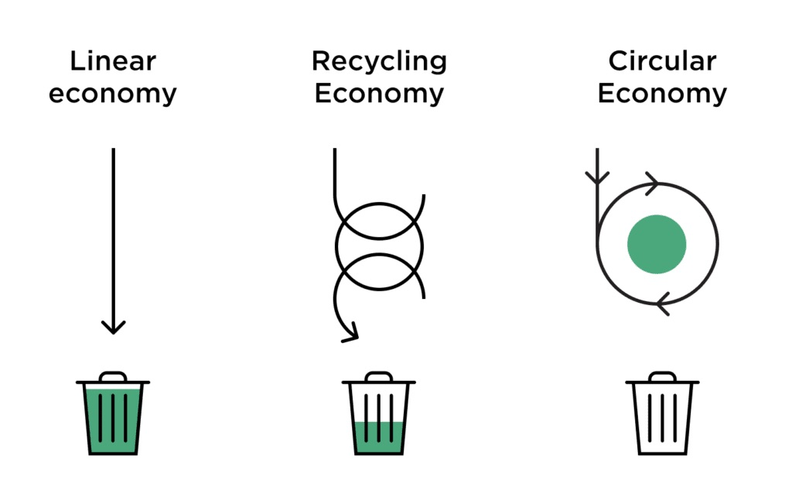
From Linear to Circular
I
Circular economy
Linear economy
Pros and Cons of Linear and Circular Economy
—----------------------------------------------
Planned obsolescence
Right to Repair
Circular raw materials
—-----------------------------------------------
Circular design
Circularity and sustainability
—-----------------------------------------------
Cases Studies
Bibliografie
​​
Image Ref:2
Image Ref:3

Slide 3
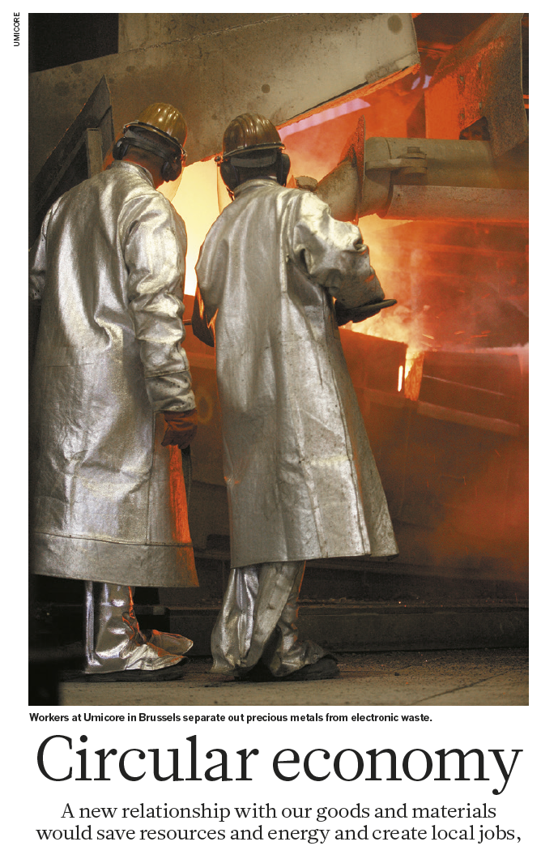
Circular Economy I
“When my battered 1969 Toyota car approached the age of 30, I decided that her body deserved to be remanufactured. After 2 months and 100 hours of work, she returned home in her original beauty. “I am so glad you finally bought a new car,” my neighbour remarked. Quality is still associated with newness not with caring; long-term use as undesirable, not resourceful.”(Ref1:https://www.nature.com/articles/531435a#citeas )
Image Ref:4
Image Ref:3

Slide 4
Circular Economy I
“When my battered 1969 Toyota car approached the age of 30, I decided that her body deserved to be remanufactured. After 2 months and 100 hours of work, she returned home in her original beauty. “I am so glad you finally bought a new car,” my neighbour remarked. Quality is still associated with newness not with caring; long-term use as undesirable, not resourceful.” (Ref 1 https://www.nature.com/articles/531435a#citeas)
Circular economy model: Involves sharing, leasing, reusing, repairing, refurbishing, and recycling to extend product life cycles.
Goal: Minimize waste by keeping materials within the economy through recycling, creating further value.
Departure from linear economic model: Traditional take-make-consume-throw away pattern replaced.
Image Ref:4
Ref:2-https://www.europarl.europa.eu/news/en/headlines/economy/20151201STO05603/circular-economy-definition-importance-and-benefits
Image Ref:3

Slide 5
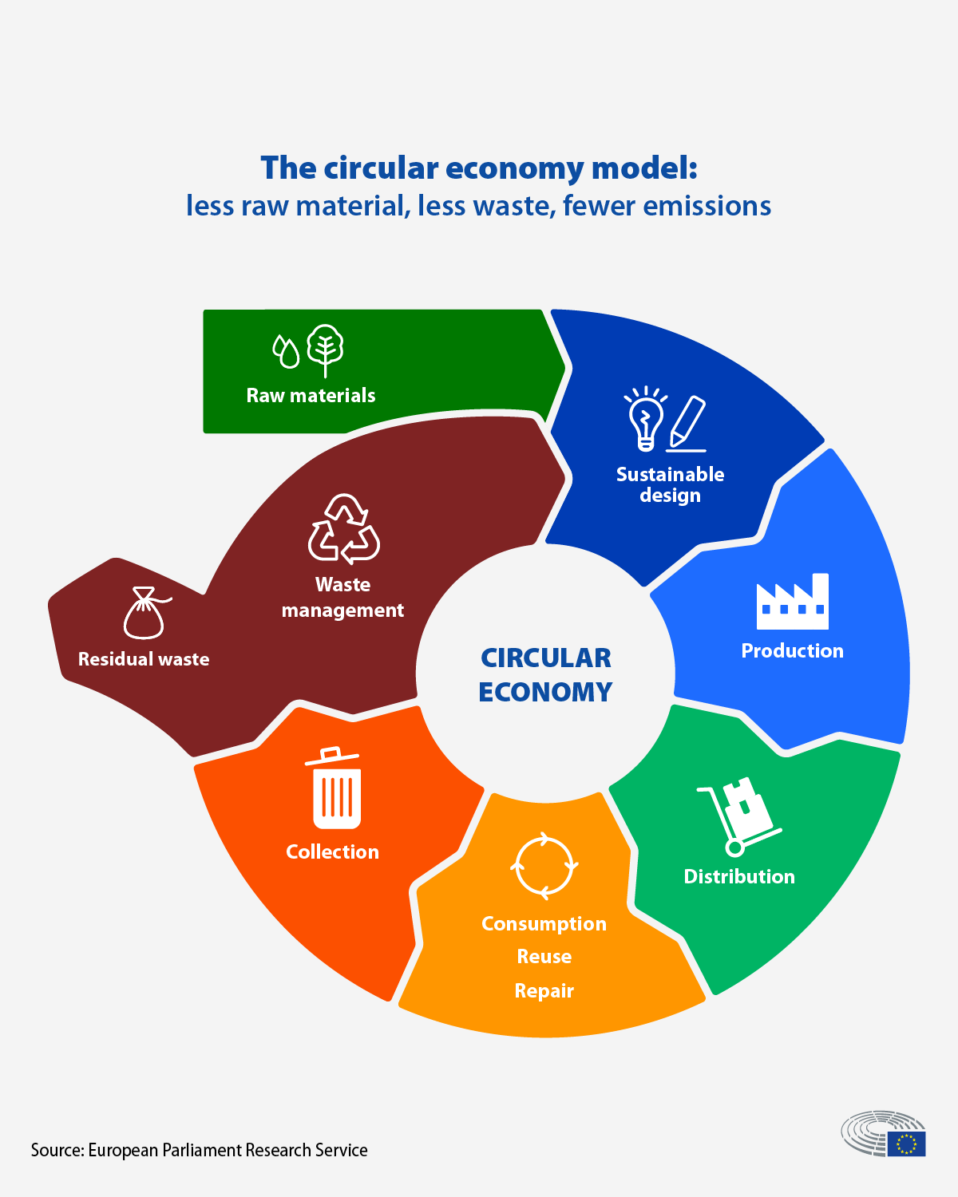
Circular Economy I
Definition / Values
Circular Economy: Two Key Groups.
1. Extend Service Life.
Focused on reuse, repair, remanufacture, upgrades, and retrofits.
Goal: Prolong the lifespan of goods.
2. Transform into Resources.
Emphasizes recycling materials from old goods.
Goal: Turn old items into new resources.
People-Centric Model
Ownership to Stewardship: Shift from owning to managing goods.
Consumers as Users and Creators: Active involvement in product use and creation.
Image Ref:5
Ref 1:https://www.nature.com/articles/531435a#citeas
Ref:2: https://www.europarl.europa.eu/news/en/headlines/economy/20151201STO05603/circular-economy-definition-importance-and-benefits
Ref 3: https://www.ellenmacarthurfoundation.org/towards-the-circular-economy-vol-1-an-economic-and-business-rationale-for-an
Image Ref:3

Slide 6
Circular Economy I
Definition / Values
Circular Economy: Two Key Groups.
People-Centric Model
Remanufacturing Benefits.
Infrastructure Building: Supports new infrastructure development.
Job Creation: Generates new skill jobs.
Global Initiatives.
South Korea, China, and the United States: Research programs to boost circular economies with a focus on remanufacturing and reuse.
Europe: Taking gradual steps; initiatives from the Swiss foundation MISTRA and the EU Horizon 2020 Program since 2014.
Image Ref:5
Ref 1:https://www.nature.com/articles/531435a#citeas
Ref:2: https://www.europarl.europa.eu/news/en/headlines/economy/20151201STO05603/circular-economy-definition-importance-and-benefits
Ref 3: https://www.ellenmacarthurfoundation.org/towards-the-circular-economy-vol-1-an-economic-and-business-rationale-for-an
Image Ref:3

Slide 7
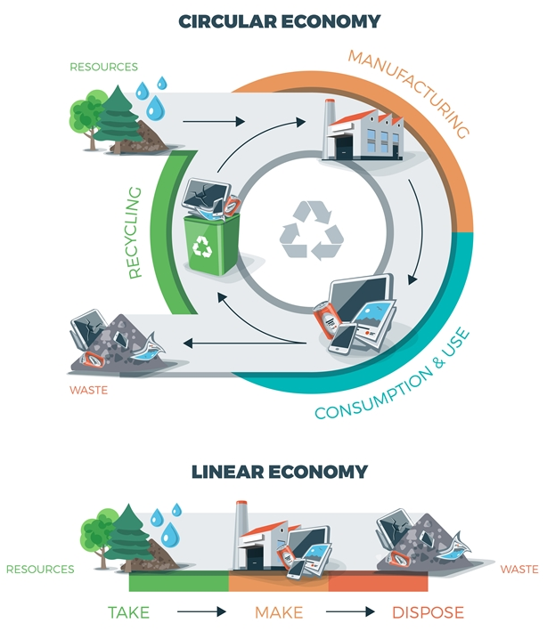
Circular Economy I
Circular Economy vs. 'Take-Make-Dispose
Circular: Emphasizes sustainability and recycling.
Linear: Focuses on efficiency in resource use.
Benefits of Circular Model.
Infrastructure and Jobs: Promotes development and job creation.
Sustainability: Reduces waste and environmental impact.
Cost Savings: Offers economic efficiency.
Scaling the Concept.
Learn from Success: Identify and replicate successful circular business models.
Key Factors: Understand elements contributing to success.
Sector Potential: Identify sectors and products suitable for circular practices.
Ref 1:https://www.nature.com/articles/531435a#citeas
Ref:2: https://www.europarl.europa.eu/news/en/headlines/economy/20151201STO05603/circular-economy-definition-importance-and-benefits
Ref 3: https://www.ellenmacarthurfoundation.org/towards-the-circular-economy-vol-1-an-economic-and-business-rationale-for-an
Image Ref:6
Image Ref:3

Slide 8
Circular Economy I
Circular Economy vs. 'Take-Make-Dispose
Benefits of Circular Model.
Scaling the Concept.
Leveraging Shifts
Technology: Use advancements to accelerate circular transition.
Consumer Behaviour: Align with changing consumer preferences.
EU Research Highlights.
Methodology: Reviewed products, conducted economic analysis, and interviewed experts.
Potential Savings: Up to USD 630 billion in advanced scenarios for EU manufacturing sectors.
Ref 1:https://www.nature.com/articles/531435a#citeas
Ref:2: https://www.europarl.europa.eu/news/en/headlines/economy/20151201STO05603/circular-economy-definition-importance-and-benefits
Ref 3: https://www.ellenmacarthurfoundation.org/towards-the-circular-economy-vol-1-an-economic-and-business-rationale-for-an
Image Ref:6
Image Ref:3

Slide 9
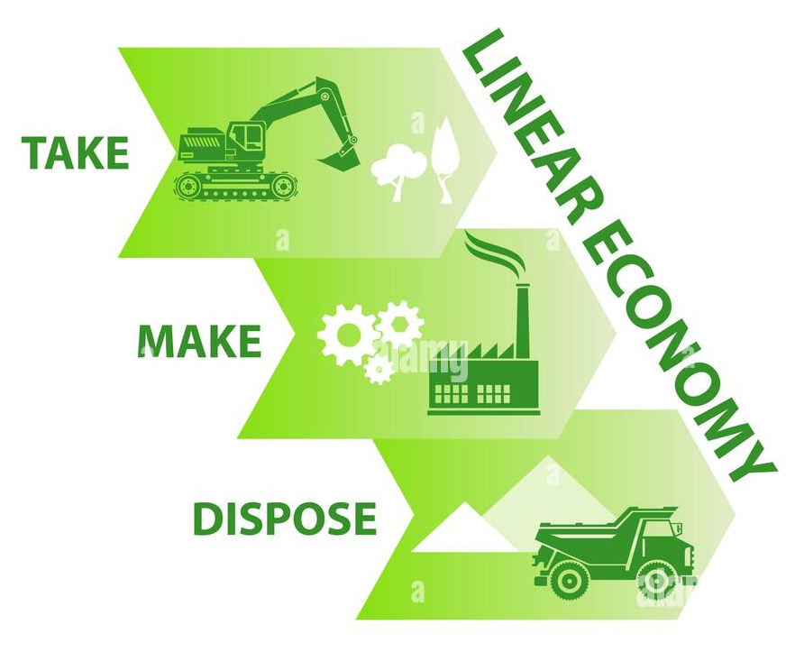
Linear Economy I
Definition
Operation Type
Operates linearly, resembling a river, where natural resources are transformed into products through a series of value-adding steps.
Values
Driven by the "bigger-better-faster-safer" syndrome, influenced by fashion, emotion, and the pursuit of progress.
Efficient at overcoming scarcity challenges but tends to be profligate in resource usage, particularly in markets already saturated with products.
Individual and collective stewardship
Companies thrive by focusing on the mass production and sale of high volumes of inexpensive and trendy goods.
Ownership and responsibility for risks and waste transfer to the buyer at the point of sale, allowing them to decide on the fate of the product, such as reuse, recycling, or disposal.
Image Ref:7
Ref 3: The limits of linear consumption https://www.ellenmacarthurfoundation.org/towards-the-circular-economy-vol-1-an-economic-and-business-rationale-for-an
Image Ref:3

Slide 10
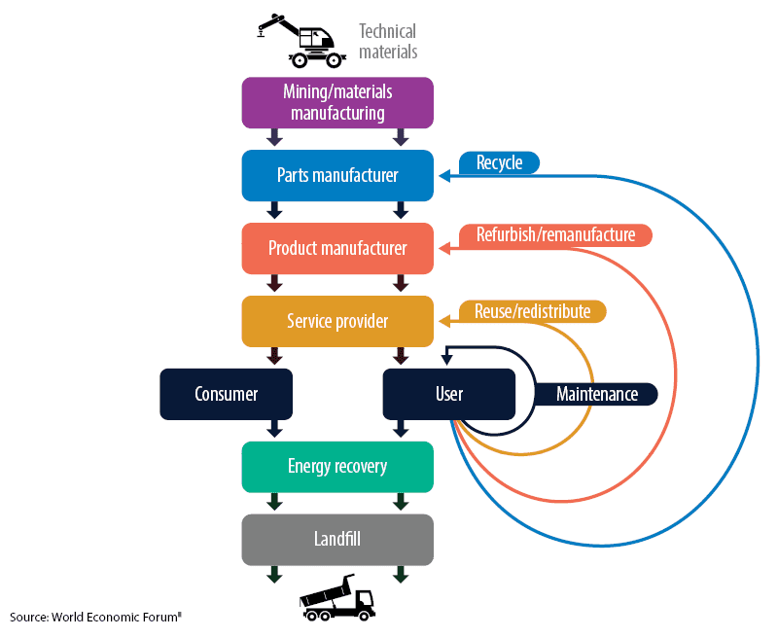
Linear Economy I
1. Linear Consumption Limits.
Industrial economy primarily follows a 'take-make-dispose' pattern.
In 2010, about 65 billion tonnes of raw materials entered the economic system, expected to rise to approximately 82 billion tonnes in 2020.
Despite improvements in resource efficiency, the linear model lacks systematic approaches to eliminate material leakage and disposal.
2. Business Risks in the Linear System.
Companies face increased exposure to risks, including higher resource prices and supply disruptions.
Rising and unpredictable resource prices coupled with competition and stagnating demand pose challenges.
Real prices of natural resources have risen since the turn of the millennium, erasing a century's worth of declines.
Image Ref:8
Ref 3: The limits of linear consumption https://www.ellenmacarthurfoundation.org/towards-the-circular-economy-vol-1-an-economic-and-business-rationale-for-an
Image Ref:3

Slide 11
Linear Economy I
1. Linear Consumption Limits.
2. Business Risks in the Linear System.
3. Price Volatility and Future Concerns:
The first decade of the 21st century saw unprecedented price volatility for metals, food, and non-food agricultural output.
Anticipation of sustained high prices and volatility due to robust growth, population increase, urbanization, and rising resource extraction costs.
With three billion new middle-class consumers expected by 2030, addressing these challenges becomes crucial for meeting growth requirements.
Image Ref:8
Ref 3: The limits of linear consumption https://www.ellenmacarthurfoundation.org/towards-the-circular-economy-vol-1-an-economic-and-business-rationale-for-an
Image Ref:3

Slide 12
Linear Economy I
Pros:
Familiarity
Simplicity
Established Processes
Immediate Returns
Lower Initial Costs
Clear Supply Chains
Cons:
Resource Depletion
Environmental Impact
Waste Generation
Vulnerability to Disruptions
Dependence on Scarce Resources
Limited Long-Term Sustainability

Slide 13
Linear Economy Circular Economy I
Pros:
Familiarity
Simplicity
Established Processes
Immediate Returns
Lower Initial Costs
Clear Supply Chains
Cons:
Resource Depletion
Environmental Impact
Waste Generation
Vulnerability to Disruptions
Dependence on Scarce Resources
Limited Long-Term Sustainability
Pros:
Resource Efficiency
Environmental Benefits
Innovation, Job Creation
Cost Savings
Resilience to Disruptions
Cons:
Initial Costs
Resistance to Change
Complexity, Coordination
Job Displacement
Consumer Behavior
Limited Applicability

Slide 14
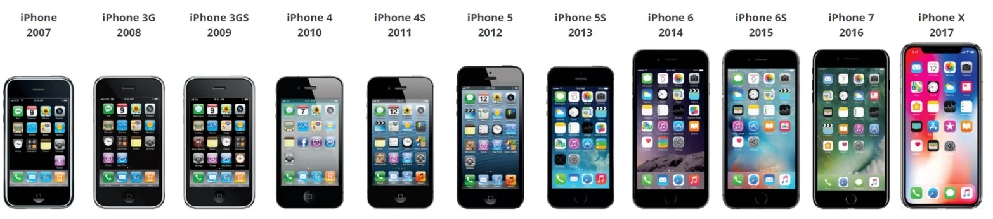
Planned obsolescene I
Image Ref:9
Image Ref:3

Slide 15
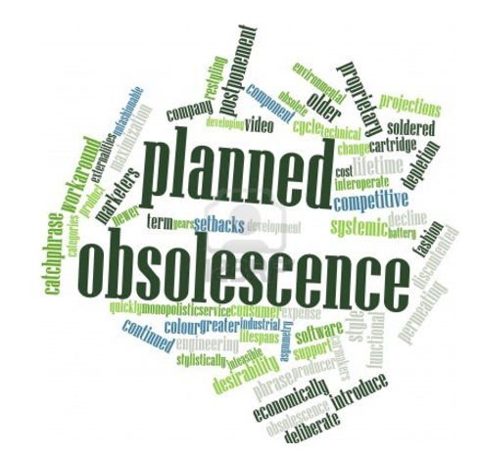
Planned obsolescene I
Definition
Planned obsolescence is a strategy where products are intentionally designed to have a limited lifespan, encouraging consumers to replace them with newer models, thus driving continuous demand and sales.
Reconvert
Factors Driving Premature Obsolescence.
Real limits of Circularity.
Mitigating Premature Obsolescence.
Specific Types of Premature obsolescence
-The “Weakest Link” Component
-Fashion Obsolescence
-Economic Obsolescence
Transitioning to circular design involves resilient product design, modular production, and a shift in ownership dynamics. Addressing specific obsolescence types—planned, fashion, and economic—is key for sustainability and circularity.
Image Ref:10
Ref 3: The limits of linear consumption https://www.ellenmacarthurfoundation.org/towards-the-circular-economy-vol-1-an-economic-and-business-rationale-for-an
Ref 4 : Empowering Sustainable Consumption by Giving Back to Consumers the ‘Right to Repair’
Ricardo J Hernandez 1,2,* , Constanza Miranda 1 and Julian Goñi DILAB School of Engineering, Pontificia Universidad Católica de Chile,
Image Ref:3

Slide 16
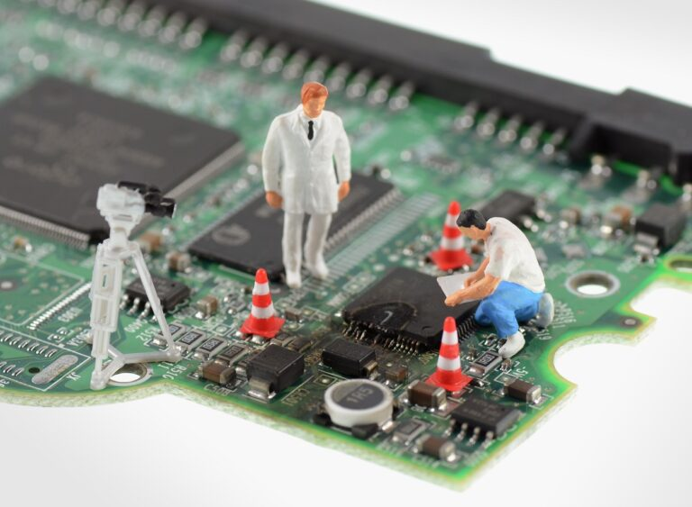
Planned obsolescene I
Factors driving premature obsolescence
Technical Weaknesses:
Products prone to technical failures may be discarded prematurely, contributing to unnecessary waste.
Fashion Trends.:
Rapidly changing styles and trends can lead to the premature retirement of functional products for aesthetic reasons.
Economic Considerations:
High maintenance costs or perceived inefficiencies may render products economically obsolete, encouraging early disposal.
Regulatory Factors:
Regulations or policies may influence product lifecycles, potentially leading to premature obsolescence based on compliance requirements or incentives.
Image Ref:11
Ref 3: The limits of linear consumption https://www.ellenmacarthurfoundation.org/towards-the-circular-economy-vol-1-an-economic-and-business-rationale-for-an
Ref 4 : Empowering Sustainable Consumption by Giving Back to Consumers the ‘Right to Repair’
Ricardo J Hernandez 1,2,* , Constanza Miranda 1 and Julian Goñi DILAB School of Engineering, Pontificia Universidad Católica de Chile,
Image Ref:3

Slide 17
Planned obsolescene I
Real limits to circularity
1. Physical Constraints (Second Law of Thermodynamics).
The natural tendency for systems to move towards disorder, imposing limits on the perpetual reuse of materials and energy.
2. Exception rather than the rule today.
Achieving complete circularity is currently uncommon, with most systems falling short due to various challenges and constraints.
Image Ref:11
-Factors driving premature obsolescence
Ref 3: The limits of linear consumption https://www.ellenmacarthurfoundation.org/towards-the-circular-economy-vol-1-an-economic-and-business-rationale-for-an
Ref 4 : Empowering Sustainable Consumption by Giving Back to Consumers the ‘Right to Repair’
Ricardo J Hernandez 1,2,* , Constanza Miranda 1 and Julian Goñi DILAB School of Engineering, Pontificia Universidad Católica de Chile,
Image Ref:3

Slide 18
Planned obsolescene I
Mitigating Premature Obsolescence:
The 'Weakest Link' Component:
Planned obsolescence often results from the failure of a single component, leading to the discarding of the entire product. To counteract this, mitigation strategies include designing for even wear, promoting individual component sales, and reconsidering business models to encourage ownership retention.
Fashion Obsolescence:
To combat premature product retirement due to evolving fashion trends, consider refreshing products through cosmetic redesign. This approach provides consumers with a renewed sense of novelty and added value without the need for new material inputs.
Economic Obsolescence:
When the cost of ownership surpasses that of purchasing a new item, economic obsolescence occurs. Mitigation involves designing products for easy disassembly and strategic part replacement. Additionally, creating infrastructure to facilitate the return of products to manufacturers can support the reuse of components and simplify exchanges or upgrades, aligning with technological progress.
Image Ref:11
-Factors driving premature obsolescence
-Real limits to circularity
Ref 3: The limits of linear consumption https://www.ellenmacarthurfoundation.org/towards-the-circular-economy-vol-1-an-economic-and-business-rationale-for-an
Ref 4 : Empowering Sustainable Consumption by Giving Back to Consumers the ‘Right to Repair’
Ricardo J Hernandez 1,2,* , Constanza Miranda 1 and Julian Goñi DILAB School of Engineering, Pontificia Universidad Católica de Chile,
Image Ref:3

Slide 19
Planned obsolescene I
To tackle Planned Obsolescence
Addressing Plan Obsolescence requires a multifaceted approach, encompassing technical, fashion-related, economic, and regulatory considerations. By emphasizing even wear in design, refreshing products cosmetically, and implementing strategies for disassembly and part replacement, the transition towards a more circular and sustainable product lifecycle becomes feasible.
Image Ref:11
-Factors driving premature obsolescence
-Real limits to circularity
-Mitigating premature obsolescence
.The “weakest link” Component
.Fashion Obsolescence
.Economic Obsolescence
Ref 3: The limits of linear consumption https://www.ellenmacarthurfoundation.org/towards-the-circular-economy-vol-1-an-economic-and-business-rationale-for-an
Ref 4 : Empowering Sustainable Consumption by Giving Back to Consumers the ‘Right to Repair’
Ricardo J Hernandez 1,2,* , Constanza Miranda 1 and Julian Goñi DILAB School of Engineering, Pontificia Universidad Católica de Chile,
Image Ref:3

Slide 20

Right to Repair I
Introduction to Sustainable Development
Urgent Call for Transformation: Sustainable development urges a transformation in how society fulfils its needs.
Linear Model Obsolete: The traditional 'take-make-dispose' model is no longer a viable option for meeting evolving demands.
Diverse Approaches: Over the past 40 years, various approaches have been developed to promote sustainable products and services.
Image Ref:12
Ref 4 : Empowering Sustainable Consumption by Giving Back to Consumers the ‘Right to Repair’
Ricardo J Hernandez 1,2,* , Constanza Miranda 1 and Julian Goñi DILAB School of Engineering, Pontificia Universidad Católica de Chile,
Ref 5 : Journal of Cleaner Production Business model innovation for circular economy and sustainability: Technical University of Denmark Marina P.P. Pieroni , Tim C. McAloone, Daniela C.A. Pigosso
Ref 6: https://www.sciencedirect.com/science/article/abs/pii/S2452223621000912c
Re /: https://repair.eu/
Image Ref:3

Slide 21
Right to Repair I
Introduction to Sustainable Development
Importance of Repairability in Circular Economy
Circular Economy Emphasis: Circular economy models stress the importance of longer product lifespans through technical and biological cascades.
Crucial Role of Repairability: Repairability is a fundamental aspect of technical cascades, minimizing the demand for new resources in the production of goods.
Dependence on Variables: The ability to repair products is contingent on multiple variables, including design, business models, and consumer behavior.
Image Ref:12
Ref 4 : Empowering Sustainable Consumption by Giving Back to Consumers the ‘Right to Repair’
Ricardo J Hernandez 1,2,* , Constanza Miranda 1 and Julian Goñi DILAB School of Engineering, Pontificia Universidad Católica de Chile,
Ref 5 : Journal of Cleaner Production Business model innovation for circular economy and sustainability: Technical University of Denmark Marina P.P. Pieroni , Tim C. McAloone, Daniela C.A. Pigosso
Ref 6: https://www.sciencedirect.com/science/article/abs/pii/S2452223621000912c
Re /: https://repair.eu/
Image Ref:3

Slide 22
Right to Repair I
Introduction to Sustainable Development
Importance of Repairability in Circular Economy
Factors Inhibiting Repairability
Lack of Knowledge: Consumers often lack knowledge about how products function, hindering their ability to perform repairs.
Limited Access: Insufficient access to spare parts, technical information, and restrictive contracts restricts repair options.
Economic Incentives: Economic factors, such as the cost of repair compared to buying new products, often discourage repair efforts.
Emotional and Economic Attachment: Consumer attachment, both emotionally and economically, influences decisions to repair or replace products.
Design and Manufacturing Challenges: Poor design and manufacturing features, like non-modular structures, can impede the repairability of product
Image Ref:12
Ref 4 : Empowering Sustainable Consumption by Giving Back to Consumers the ‘Right to Repair’
Ricardo J Hernandez 1,2,* , Constanza Miranda 1 and Julian Goñi DILAB School of Engineering, Pontificia Universidad Católica de Chile,
Ref 5 : Journal of Cleaner Production Business model innovation for circular economy and sustainability: Technical University of Denmark Marina P.P. Pieroni , Tim C. McAloone, Daniela C.A. Pigosso
Ref 6: https://www.sciencedirect.com/science/article/abs/pii/S2452223621000912c
Re /: https://repair.eu/
Image Ref:3

Slide 23
Right to Repair I
Introduction to Sustainable Development
Importance of Repairability in Circular Economy
Factors Inhibiting Repairability
EU Directive - Right to Repair
Directive Overview: The new EU directive, known as "Right to Repair," underscores the importance of repairability in fostering circular economies.
Addressing Barriers: Expected to address current barriers to repairing products, facilitating a shift in consumer-producer-product dynamics.
Transformation Potential: Potential to transform relationships between producers, users, and products by promoting repair as a sustainable practice.
Discussion and Proposed Actions: Exploring the anticipated impact and proposing necessary actions for the successful implementation of the "Right to Repair" directive.
Image Ref:12
Ref 4 : Empowering Sustainable Consumption by Giving Back to Consumers the ‘Right to Repair’
Ricardo J Hernandez 1,2,* , Constanza Miranda 1 and Julian Goñi DILAB School of Engineering, Pontificia Universidad Católica de Chile,
Ref 5 : Journal of Cleaner Production Business model innovation for circular economy and sustainability: Technical University of Denmark Marina P.P. Pieroni , Tim C. McAloone, Daniela C.A. Pigosso
Ref 6: https://www.sciencedirect.com/science/article/abs/pii/S2452223621000912c
Re /: https://repair.eu/
Image Ref:3

Slide 24
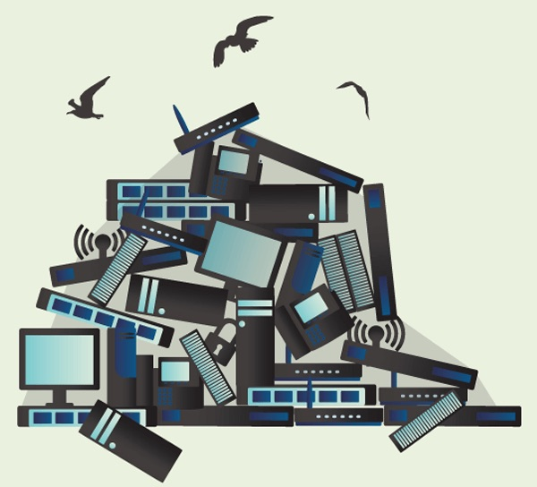
Circular Raw Materials I
Critical Raw Materials and Circular Economy
JRC (Joint Recerch Center) Contribution to the EU Circular Economy Action Plan
Importance of Raw Materials:
Raw materials are the foundation of Europe's current and future economy, crucial for jobs, competitiveness, and enhancing the quality of life.
Critical Raw Materials (CRMs):
Some raw materials are of particular concern due to their high economic importance and supply risk; these are termed Critical Raw Materials.
EU's Commitment:
The European Union is dedicated to fostering a circular economy, and the JRC plays a pivotal role in contributing to the Circular Economy Action Plan.
Image Ref:13
Re 8: https://www.researchgate.net/publication/321998000 Critical raw materials and the circular economy
Image Ref:3

Slide 25
Circular Raw Materials I
Circular Use in the EU
EOL-RIR as a Measure:
The End-of-life Recycling Input Rate (EOL-RIR) is a key metric for assessing circular use, measuring the proportion of total material input from recycled post-consumer scrap.
Challenges in Achieving Circularity:
Despite the potential for high recycling rates, challenges include the lack of cost-effective sorting and recycling technologies, locked-up supply in long-life assets, and growing demand in various sectors.
Recycling Performance Examples:
Specific examples like vanadium, tungsten, cobalt showcase notable recycling input rates.
Illustrative Figure:
A visual representation of EOL-RIR for specific CRMs in the EU, demonstrating the varying rates.
Image Ref:13
Re 8: https://www.researchgate.net/publication/321998000 Critical raw materials and the circular economy
Image Ref:3

Slide 26
Circular Raw Materials I
Circular Use in the EU
Sectorial Perspective
Significance of Sector Analysis:
Understanding CRMs within specific sectors (e.g., automotive, renewable energy) is crucial for a comprehensive view.
Examples of Sector-Specific CRMs:
Highlight critical raw materials in specific sectors, emphasizing the diverse raw material needs across industries.
Complementary Assessments:
Advocate for complementary sector-specific assessments to capture nuances missed in an economy-wide analysis.
Illustrative Image:
Visual representation indicating the complexity of CRM usage within different sectors.
Image Ref:13
Re 8: https://www.researchgate.net/publication/321998000 Critical raw materials and the circular economy
Image Ref:3

Slide 27
Circular Raw Materials I
Circular Use in the EU
Sectorial Perspective
Next Steps
Summary of Findings:
The presentation provides insights into CRM use in the EU, emphasizing its current non-circular nature.
Policy Recommendations:
Recommendations include enhancing legislative frameworks, developing preventive initiatives, and supporting standardization activities.
Research and Development:
Emphasize the importance of supporting innovative, efficient, and cost-effective technologies for CRM extraction and material-efficient solutions.
Public Awareness:
Highlight the need to raise public awareness about the fundamental role of CRMs.
Image Ref:13
Re 8: https://www.researchgate.net/publication/321998000 Critical raw materials and the circular economy
Image Ref:3

Slide 28

Circular Design I
Unveiling Circular Design
Circular design:
A cornerstone of the circular economy.
Shifts from product-focused sustainability to holistic business models.
Process:
Designers strategically plan for products with a minimal environmental impact.
Image Ref:14
Ref 9:https://www.researchgate.net/publication/321998000 Critical raw materials and the circular economy
Ref:10: https://www.designorate.com/the-future-circular-economy-circular-design/
Image Ref:3

Slide 29
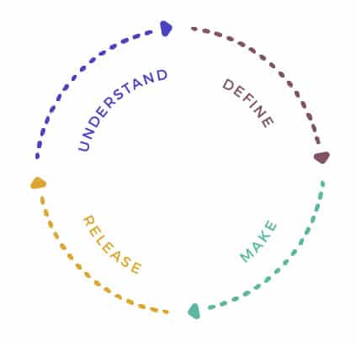
Circular Design I
Unveiling Circular Design
The Essence of Circular Design
Four-stage Process:
Understand:
Analyzing user needs and brainstorming circular solutions.
Define:
Forming business goals and creating a multidisciplinary team.
Make:
Executing user-centered research, prototyping, and material definition.
Release:
Launching the product, collecting consumer feedback, completing the business model.
Image Ref:15
Ref 9:https://www.researchgate.net/publication/321998000 Critical raw materials and the circular economy
Ref:10: https://www.designorate.com/the-future-circular-economy-circular-design/
Image Ref:3

Slide 30
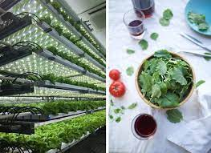
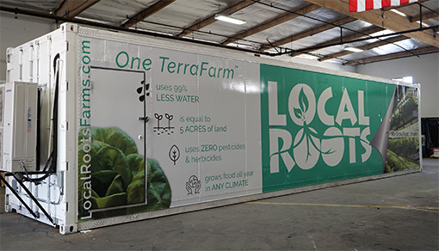
Circular Design I
Unveiling Circular Design
The Essence of Circular Design
Case Study:
Local Roots - Transforming Agriculture with Circular Design.
Circular Design Implementation:
Reusing shipping containers as sustainable farms.
Full refurbishment and quality checks ensure longevity.
Remanufacturing: Parts reused in the manufacturing process.
Recycling: Materials recycled for use in other industries.
Sustainable Impact:
Year-round, resource-efficient farming.
97% less water, no pesticides, and herbicides.
Business Model Innovation:
Circular design integrated into the core of Local Roots' business.
Example of successful circular economy principles in action.
Conclusion:
Local Roots stands as a prime example of circular design fostering sustainability.
Image Ref:16
Image Ref:17
Ref 9:https://www.researchgate.net/publication/321998000 Critical raw materials and the circular economy
Ref:10: https://www.designorate.com/the-future-circular-economy-circular-design/
Re:11 https://www.builtinla.com/2017/12/13/agtech-local-roots-shipping-containers
Image Ref:3

Slide 31
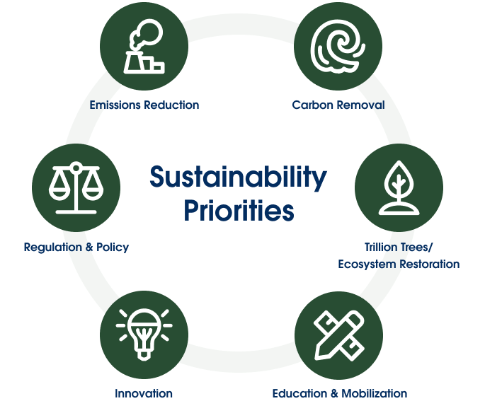
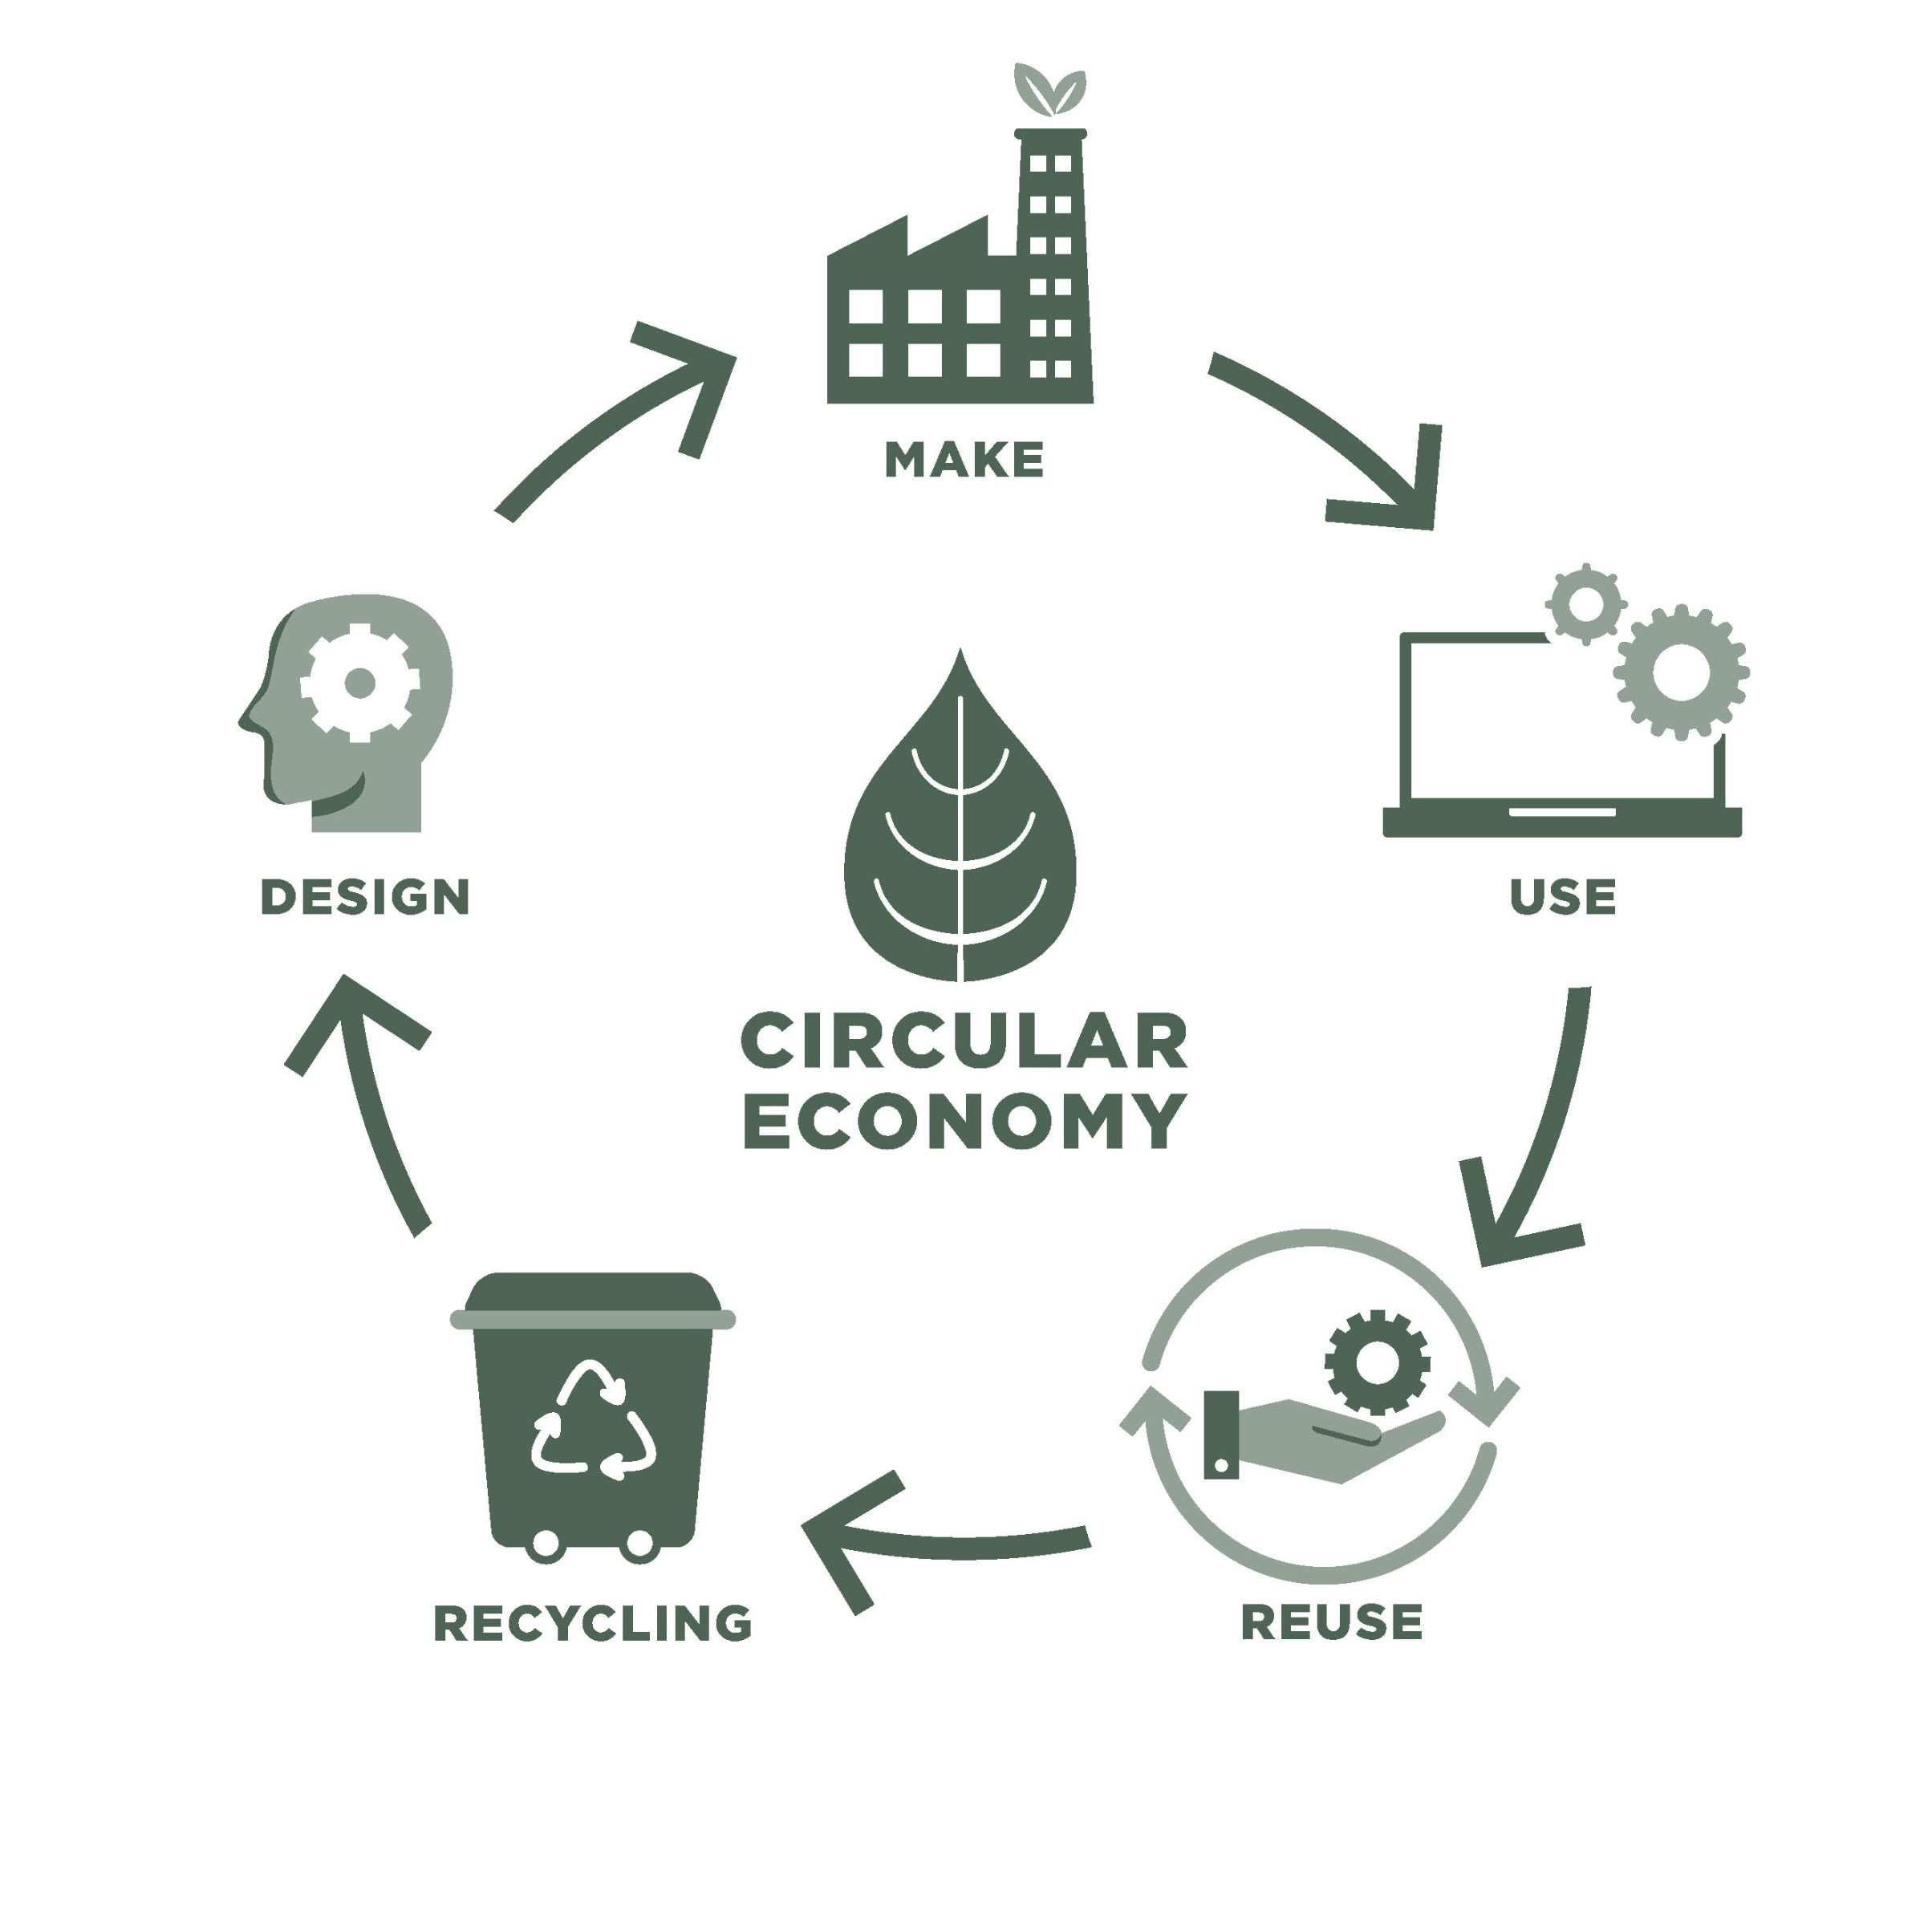
Circularity vs Sustainability I
Introduction to Circularity vs. Sustainability
Definition of Sustainability:
"Sustainability is the pursuit of practices that meet current needs without compromising the ability of future generations to meet their own needs."
Definition of Circularity:
"Circularity, within the context of the circular economy, emphasizes regenerating resources and minimizing waste through a closed-loop system."
Importance:
"Understanding these concepts is crucial for businesses and societies to address environmental challenges and foster responsible resource management."
Image Ref:18
Image Ref:19
Ref 9:https://www.researchgate.net/publication/321998000 Critical raw materials and the circular economy
Ref:10: https://www.designorate.com/the-future-circular-economy-circular-design/
Re:11 https://www.builtinla.com/2017/12/13/agtech-local-roots-shipping-containers
Ref:12:https://www.sciencedirect.com/science/article/abs/pii/S2452223621000912
Image Ref:3

Slide 32
Circularity vs Sustainability I
Introduction to Circularity vs. Sustainability
Understanding Sustainability
Sustainability Defined
Detailed explanation of sustainability as a holistic concept.
Three pillars of sustainability:
Environmental, social, and economic.
Examples of sustainable practices:
Renewable energy, responsible sourcing, and ethical labor practices.
Image Ref:18
Image Ref:19
Ref 9:https://www.researchgate.net/publication/321998000 Critical raw materials and the circular economy
Ref:10: https://www.designorate.com/the-future-circular-economy-circular-design/
Re:11 https://www.builtinla.com/2017/12/13/agtech-local-roots-shipping-containers
Ref:12:https://www.sciencedirect.com/science/article/abs/pii/S2452223621000912
Image Ref:3

Slide 33
Circularity vs Sustainability I
Introduction to Circularity vs. Sustainability
Understanding Sustainability
Exploring Circularity
The Concept of Circularity
"A circular economy is a system designed to minimize waste and make the most of resources by keeping them in use for as long as possible."
Circular Economy Principles
"Principles include designing for longevity, recycling, and reusing materials to create a closed-loop system."
Benefits
"Circularity aims to reduce environmental impact, enhance resource efficiency, and create a more sustainable economic model."
Image Ref:18
Image Ref:19
Ref 9:https://www.researchgate.net/publication/321998000 Critical raw materials and the circular economy
Ref:10: https://www.designorate.com/the-future-circular-economy-circular-design/
Re:11 https://www.builtinla.com/2017/12/13/agtech-local-roots-shipping-containers
Ref:12:https://www.sciencedirect.com/science/article/abs/pii/S2452223621000912
Image Ref:3

Slide 34

Circularity vs Sustainability I
Introduction to Circularity vs. Sustainability
Understanding Sustainability
Exploring Circularity
Integrating Circularity for Sustainability
Circular Practices in Sustainability
"Circular economy practices are integral to achieving broader sustainability goals."
Business Examples
"Highlighting successful cases where companies have integrated circular practices to enhance overall sustainability."
Call to Action
"Encouraging businesses to adopt circular thinking for a more sustainable future."
Image Ref:20
Ref 9:https://www.researchgate.net/publication/321998000 Critical raw materials and the circular economy
Ref:10: https://www.designorate.com/the-future-circular-economy-circular-design/
Re:11 https://www.builtinla.com/2017/12/13/agtech-local-roots-shipping-containers
Ref:12:https://www.sciencedirect.com/science/article/abs/pii/S2452223621000912
Image Ref:3

Slide 35
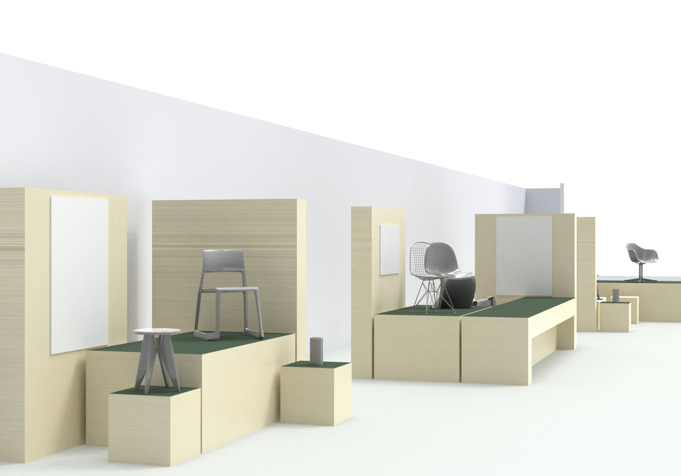
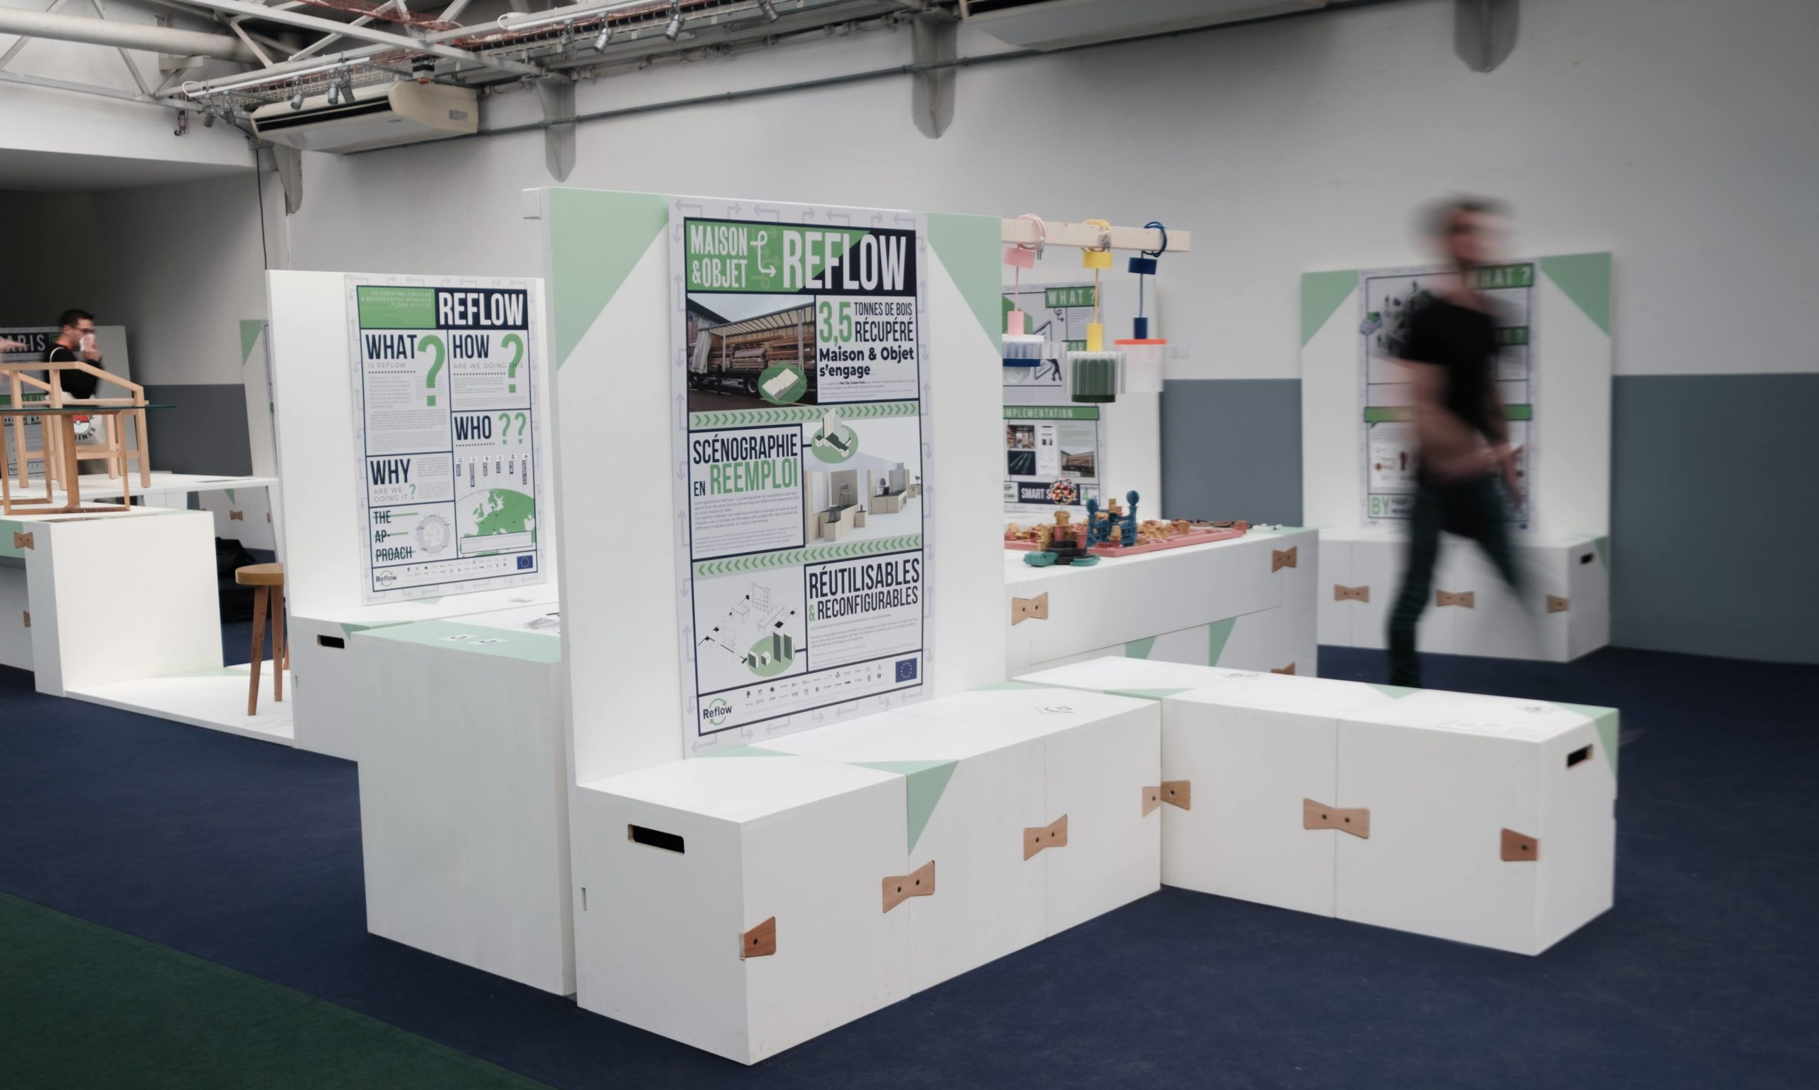
Case Studies I
Bringing Circularity to Events
Circular Scenography at Maison & Objet
Concept:
Challenge: Addressing material waste in events.
Innovation: Repurposing wood from the previous edition.
Design: Collaborated with WAO for circular scenography.
Execution: Collected 4 tons of wood, stored at Re-Store.
Curation: Enriched with circular economy-themed designs.
Visual: 3D projections of the designed scenography.
Results:
Date: Revealed on March 22, 2022, at Maison & Objet.
Feedback: Positive responses from stakeholders and visitors.
Interest: Growing interest in circular practices in the event industry.
Collaborations: Opportunities for similar projects emerged.
Next Steps: Furniture moved to Fab City Hub for extended use.
Commitment: Deepening commitment to circular principles.
Call to Action: Open for collaborations, inviting others to embrace circularity.
Image Ref:21
Image Ref:22
Ref: 13: https://reflowproject.eu/blog/how-to-bring-circularity-into-the-event-industry/
Image Ref:3

Slide 36
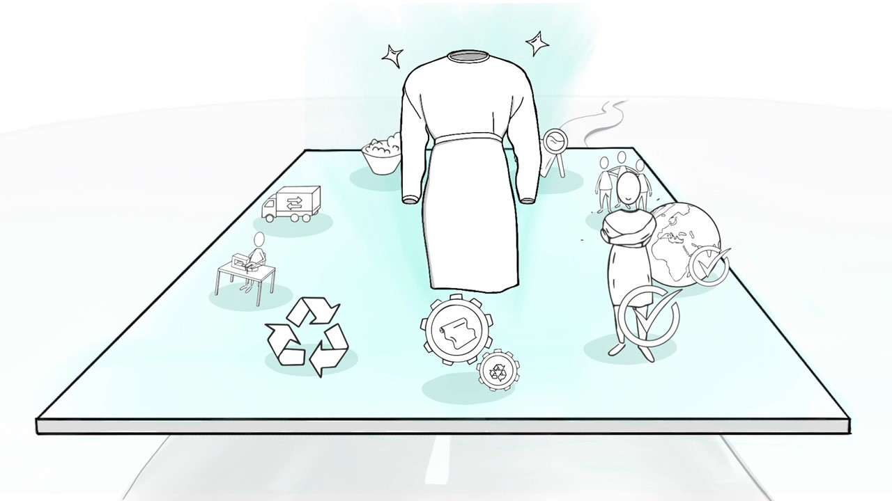
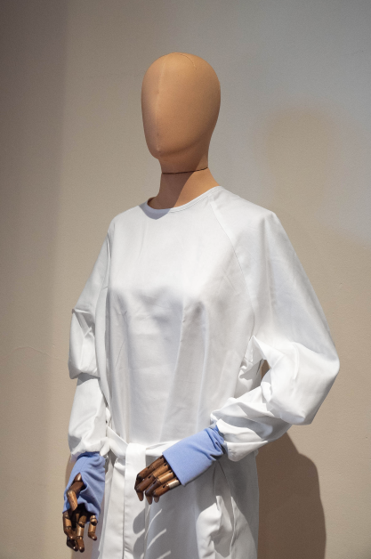
Case Studies I
Circular Isolation Gowns:
A Sustainable Shift
Concept:
Challenge: Environmental impact of disposable isolation gowns in healthcare.
Solution: Introduce reusable cotton gowns for a circular textile economy.
Partners: Collaboration with Cleanlease, healthcare institutes, creative agency Makers Unite, ReBlend, Waternet, Purfi, and Reflow.
Results:
Prototypes: Successful development of 100% recyclable cotton gowns (25 prototypes).
Environmental Impact: Aiming to replace 5 million oil-based gowns, reducing over 1000 tons of CO2 annually.
Next Steps: Preparing a 3000-gown demonstrator phase for larger production, actively seeking funding.
Image Ref:23
Image Ref:24
Ref: 14:https://reflowproject.eu/blog/the-development-of-circular-isolation-gowns-a-case-study/
Image Ref:3

Slide 37
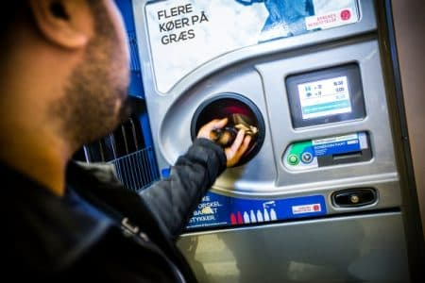
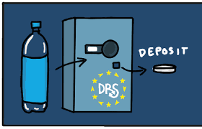
Case Studies I
Danish Deposit System
Concept:
EU Directive & Challenge: Responding to the EU directive on single-use plastics (2021) and aiming for a 90% collection rate by 2029.
Danish Model: Emulate Denmark's 100-year-old deposit system for disposable bottles and cans.
Results:
High Collection Rate: Since 2002, consistently achieves a 90% collection rate for plastic, glass, and aluminum containers.
Closed Loop System: Preserves value; refillable bottles reused up to 30 times; cans and bottles recycled into new ones.
Record Return (2021): 93% return rate, recycling 1.9 billion bottles, saving 210,000 tonnes of CO2.
Circular Economy Benefits: 95% less energy for recycled cans; effective cooperation reduces fees for manufacturers.
Image Ref:25
Image Ref:26
Ref: 15: https://stateofgreen.com/en/solutions/the-danish-deposit-return-system-for-recycling-drink-cans-and-bottles/
Image Ref:3

Slide 38

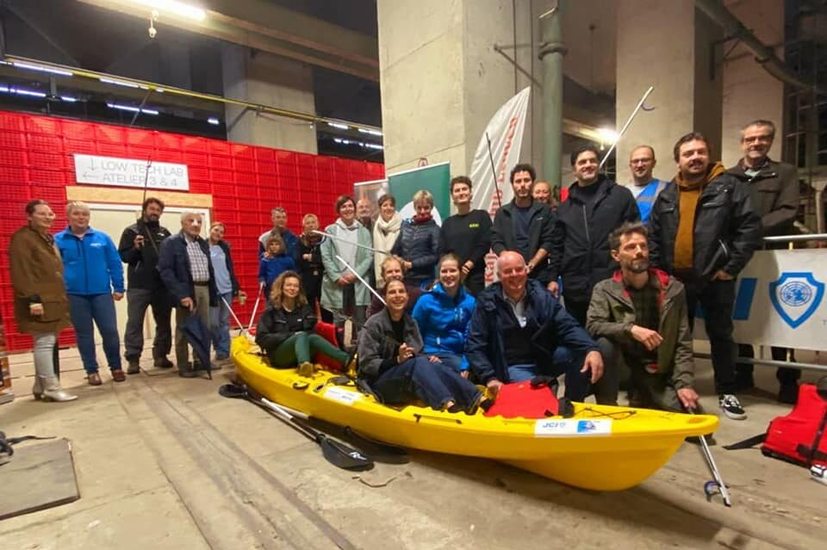
Case Studies I
Leuven River Upcycling - Concept and Results
Concept:
Collaborative initiative launched on Oct 3, 2021.
Partnership between KSKCL, Dijlejutters, JCI Leuven, and various local organizations.
Objective: Combine sport with waste reuse by collecting and processing river waste for community benefit.
Evolution: Merged efforts of Dijlejutters and JCI Leuven, with developed water routes and support from key stakeholders.
Results:
Waste Processing: High Tech Lab transforms collected plastic waste into raw materials.
New Product Creation: Sticks, pallets, and paddles produced, benefiting local sports clubs.
Circular City Vision: Aligns with Leuven 2030's sustainability model, fostering diverse partnerships.
Public Engagement: Raises awareness about river ecosystem threats, emphasizing collective responsibility.
Climbing Towards Circular City: Advances Leuven's journey to a sustainable, circular city.
Image Ref:27
Image Ref:28
Ref: 16: https://maakleerplek.be/leuvenriverupcycling/

Slide 39
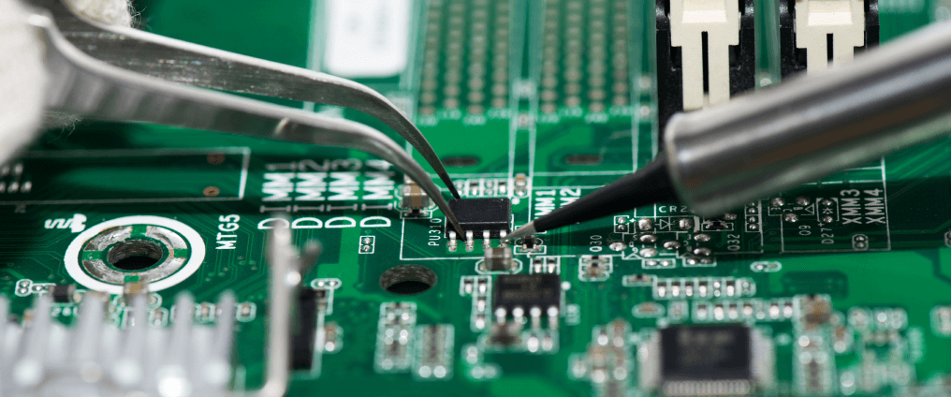
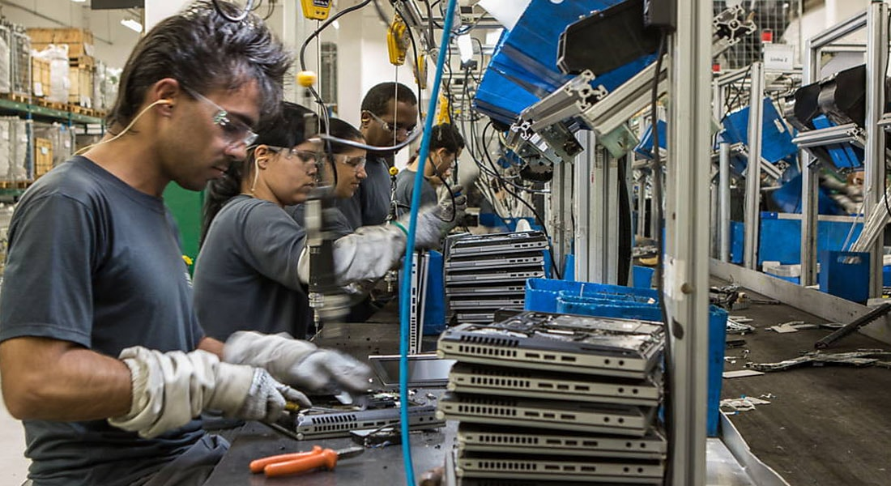
Case Studies I
HP Brazil & Sinctronics: A Circular Partnership
Concept:
Challenge:50M tons e-waste/year globally.
HP Brazil & Sinctronics join forces.
Solution:HP's outreach + Sinctronics' recovery expertise.
Circular design collaboration for increased efficiency.
Results:
Efficiency:50% reduction in collection times.
Up to 30% cost reduction.
Material Reincorporation:97% of collected materials reused.
Closed loop for plastics success.
Environmental Impact:Recycled material in HP products to increase to 45% by 2023.GHG emissions reduction.
Operational Benefits:Cost reduction and stability for HP.
Sinctronics decreases client costs by 30%.
Integrated Ecosystem:Sinctronics as Flex's circular solution unit.echnology for e-waste transformation.
Achievements:Recycled white plastic with 94% recycled material.97% recovered material back into the supply chain.
Image Ref:29
Image Ref:30
Ref: 17:https://www.ellenmacarthurfoundation.org/circular-examples/creating-a-reverse-logistics-ecosystem

Slide 40

Case Studies I
SodaStream's Circular Economy Efforts
Concept:
Addressing E-waste Surge:E-waste, including plugs, batteries, and bulbs, is a rapidly growing waste stream globally.
Over 50 million tonnes of electronic waste annually.
SodaStream's Circular Approach:
Refurbishment and Recycling:
Initiative to refurbish returned working machines.
Recycling end-of-life sparkling water makers.
Results:
Returns Testing and Refurbishment:7022 machines returned and rigorously tested.28% (2016 machines) successfully refurbished.
Efficient Recycling Process:Utilizing local e-waste recycler (eWastec).
Shredding process extracts maximum value.Materials like metals and plastics are separated for reuse.
Environmental Impact:29,432 kg of end-of-life sparkling water makers recycled since July 2020.Substantial reduction in landfill waste.
Certification for Accountability:Recyclers provide certificates documenting landfill diversion.Assurance of SodaStream's commitment to sustainability.
Image Ref:31
Ref: 18: https://www.cleanup.org.au/sodastreamsustainability

Slide 41
Images References I
Images Refereces:
image:1 https://www.din.de/en/innovation-and-research/circular-economy
Image:2 https://everydayindustries.com/circularity-strategies-for-e-commerce/
Image:3 https://interreg-baltic.eu/project/circular-spaces-interreg-baltic-sea-region/
Image:4 https://www.nature.com/articles/531435a#citeas
Image:5 https://www.europarl.europa.eu/news/en/headlines/economy/20151201STO05603/circular-economy-definition-importance-and-benefits
Image:6 https://www.engineering.pitt.edu/subsites/programs/ccep/about/what-is-ce/
Image:7 https://www.alamy.com/business-concept-of-the-linear-economy-image428880445.html
Image:8 https://www.dailyhostnews.com/plm-and-product-design-for-a-circular-economy
Image:9 https://pioneermarketing.net/2019/03/28/apples-extended-marketing-mix/
Image:10 https://shannoneileencampbell.blogspot.com/2015/01/part-ii-examples-of-planned-obsolescence.html
Image:11 https://sustainabilityguide.eu/?guide=prompt
Image:12 https://www.pubaffairsbruxelles.eu/eu-institution-news/right-to-repair-meps-want-more-durable-and-more-easily-repairable-products/
Image:13 https://www.curvature.com/resources/blog/planned-obsolescence-end-of-life-bad-for-your-budget-and-the-environment/
Image:14 https://pivotedpixel.com/graphic-design/graphic-design-and-sustainability/
Image:15 https://www.designorate.com/the-future-circular-economy-circular-design/
Image:16 https://inhabitat.com/local-roots-shipping-container-farms-achieve-cost-parity-with-traditional-farming/local-roots-terrafarm/
Image:17 https://inhabitat.com/local-roots-shipping-container-farms-achieve-cost-parity-with-traditional-farming/local-roots-terrafarm/
Image:18 https://www.salesforce.com/eu/company/sustainability/
Image:19 https://www.exenia.eu/de/nachhaltigkeit/circular-economy/
Image:20 https://online.em.jbs.cam.ac.uk/economia-circular-sustentabilidad
Image:21 https://reflowproject.eu/blog/how-to-bring-circularity-into-the-event-industry/
Image:22 https://reflowproject.eu/blog/how-to-bring-circularity-into-the-event-industry/
Image:23 https://reflowproject.eu/blog/the-development-of-circular-isolation-gowns-a-case-study/
Iamge:24 https://reflowproject.eu/blog/the-development-of-circular-isolation-gowns-a-case-study/
Image:25 https://stateofgreen.com/en/solutions/the-danish-deposit-return-system-for-recycling-drinkcans-and-bottles/
Iamge:26 https://zerowasteeurope.eu/2019/07/deposit-return-systems-an-effective-instrument-towards-a-zero-waste-future/
Image:27 https://maakleerplek.be/leuvenriverupcycling/
Image:28 https://maakleerplek.be/leuvenriverupcycling/
Image:29 https://www.ellenmacarthurfoundation.org/circular-examples/creating-a-reverse-logistics-ecosystem
Iamge:30 https://www.stylourbano.com.br/a-empresa-de-economia-circular-sinctronics-transforma-lixo-eletronico-em-novos-produtos/
Iamge:31 https://www.reveriepage.com/blog/sodastream-pledges-to-eliminate-67-billion-plastic-bottles-to-save-our-homesodastream-pledges-to-eliminate-67-billion-plastic-bottles-to-save-our-home
Image Ref:13
Image Ref:3
Image Ref:3
Image Ref:3
Image Ref:3
Image Ref:3

Slide 42
References I
Refereces:
Ref 1:https://www.nature.com/articles/531435a#citeas
Ref:2: https://www.europarl.europa.eu/news/en/headlines/economy/20151201STO05603/circular-economy-definition-importance-and-benefits
Ref 3: https://www.ellenmacarthurfoundation.org/towards-the-circular-economy-vol-1-an-economic-and-business-rationale-for-an
Ref 4 : Empowering Sustainable Consumption by Giving Back to Consumers the ‘Right to Repair’
Ricardo J Hernandez 1,2,* , Constanza Miranda 1 and Julian Goñi DILAB School of Engineering, Pontificia Universidad Católica de Chile,
Ref 5 : Journal of Cleaner Production Business model innovation for circular economy and sustainability: Technical University of Denmark Marina P.P. Pieroni , Tim C. McAloone, Daniela C.A. Pigosso
Ref 6: https://www.sciencedirect.com/science/article/abs/pii/S2452223621000912c
Ref 7: https://repair.eu/
Ref 8: https://www.researchgate.net/publication/321998000 Critical raw materials and the circular economy
Ref 9:https://www.researchgate.net/publication/321998000 Critical raw materials and the circular economy
Ref:10: https://www.designorate.com/the-future-circular-economy-circular-design/
Re:11: https://www.builtinla.com/2017/12/13/agtech-local-roots-shipping-containers
Ref:12:https://www.sciencedirect.com/science/article/abs/pii/S2452223621000912
Ref: 13: https://reflowproject.eu/blog/how-to-bring-circularity-into-the-event-industry/
Ref: 14:https://reflowproject.eu/blog/the-development-of-circular-isolation-gowns-a-case-study/
Ref: 15: https://stateofgreen.com/en/solutions/the-danish-deposit-return-system-for-recycling-drink-cans-and-bottles/
Ref: 16: https://maakleerplek.be/leuvenriverupcycling/
Ref: 17:https://www.ellenmacarthurfoundation.org/circular-examples/creating-a-reverse-logistics-ecosystem
Ref: 18:https://www.cleanup.org.au/sodastreamsustainability
Image Ref:3
Image Ref:3
Image Ref:3
Image Ref:3
Image Ref:3
Image Ref:3

