Slide 1



Maker: Education Topic
Reusability, repairability, recyclability

Slide 2



Maker: Education Topic
Reusability, repairability, recyclability

Slide 3
Topic summary | [2-3 sentences explaining general idea and aim of your training topic] This topic focuses on reusability, repairability and recyclability and aims to inspire and educate local makers, makerspaces and business support organisations about circular design, production and business modelling.
Duration (in hours and minutes) | 4 hours
Training outcomes | After completing the training trainees will: be introduced to the Interreg Baltic Sea Region programme project 2021-2027, CIRCULAR SPACES. get new insights and knowledge about circular design in theory and methods. get new insights, knowledge and practical experiences with circular design principals and tools. get new insights, knowledge and practical experiences with circular business models tools and resources. get access to an open repository of tools, templates and guides within the field of circular design and production
Training tools and resources | [Indicate what tools or resources are required for carrying out the training] For trainer: Materialepyramiden by CINARK, KADK and Vandkunsten The Upcycl: New Waste Materials Material Reuse Portal (CIRCuIT) Designing your circular transition by DDC How to get started with Distributed Design? Tools by DDC and Maker For trainee: Materialepyramiden by CINARK, KADK and Vandkunsten The Upcycl: New Waste Materials Material Reuse Portal (CIRCuIT) Designing your circular transition by DDC How to get started with Distributed Design? Tools by DDC and Maker
Training modes | [Indicate how training should be carried out or adapted to different communication formats] In person: X Online: Hybrid:
Target groups | [Indicate how training coud be used by different target groups including expected benefits for them] Makers: Independent makers and designers will benefit from getting access to a carefully curated selection of open resources and tools for transitioning existing design, prototyping and production principals and approaches into more circular models. This target group will gain practical experiences with some of the tools, and be inspired to work with open resources for kickstarting a circular transition. Makerspaces: Makerspaces, fablabs and similar collective workshop ecosystems will benefit from getting access to a carefully curated selection of open resources and tools for a circular transition. This target group will be able to share, implement and further train their local and specific community within these open resources and tools. Suppliers: Will get a communicative and branding opportunity to connect directly with independent makers and designers (customers) and to educate and inspire to use more circular materials. Start-ups: Start-ups will benefit from getting access to a carefully curated selection of open resources and tools for transitioning existing design, prototyping and production principals and approaches into more circular models. This target group will gain practical experiences with some of the tools, and be inspired to work with open resources for kickstarting a circular transition. SMEs: SMEs will benefit from getting access to a carefully curated selection of open resources and tools for transitioning existing design, prototyping and production principals and approaches into more circular models. This target group will gain practical experiences with some of the tools, and be inspired to work with open resources for kickstarting a circular transition. Business support organisations: Business Support Organisations will gain an understanding of the practices of physical entrepreneurs, makers and makerspaces thereby qualifying their own input and tools.

Slide 4

TOPIC OVERVIEW
About CIRCULAR SPACES and CIRCULAR MAKER EDUCATION TOPIC
  Introduction by Maker
Session 1
Session 2
Session 3
Session 4
Introduction to circular design: design principals, good practices, mindset and methods
  Reusability, repairability, recyclability
Kickstarting your circular transition (strategies, value and ecosystems)
  Facilitated by Maker and Danish Design Center
CIRCULAR MAKER tool box of open resources: How to pursue your circular journey?
  Facilitated by Maker

Slide 5


INTRODUCTION
SESSION 1
About CIRCULAR SPACES and CIRCULAR MAKER EDUCATION TOPIC

Slide 6
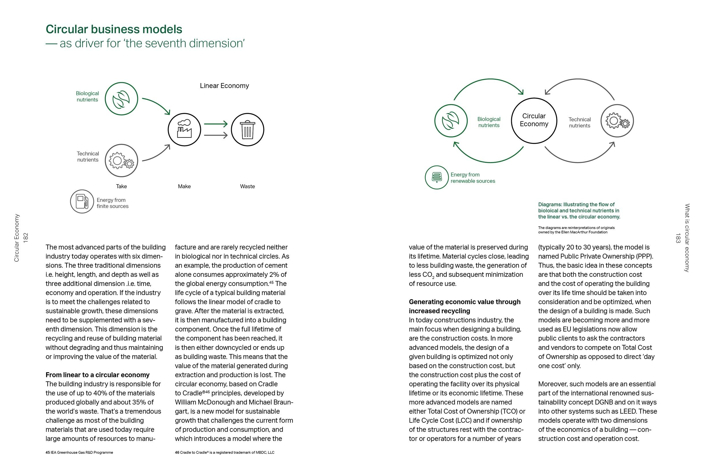
From linear to circular
Recyclability and reusability - the future of material flows is focusing on recirculation of materials, direct reuse and material exchange ecosystems

Slide 7
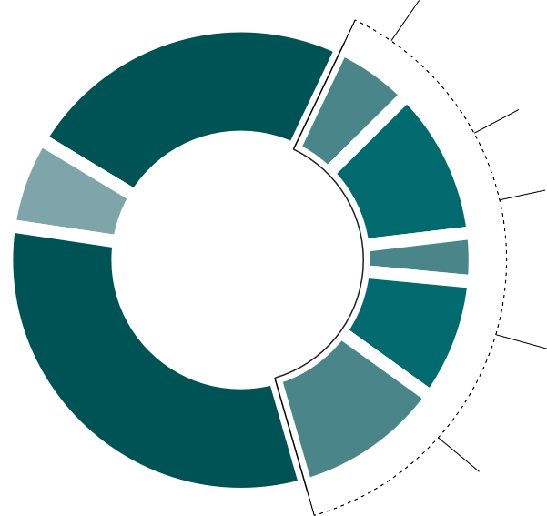
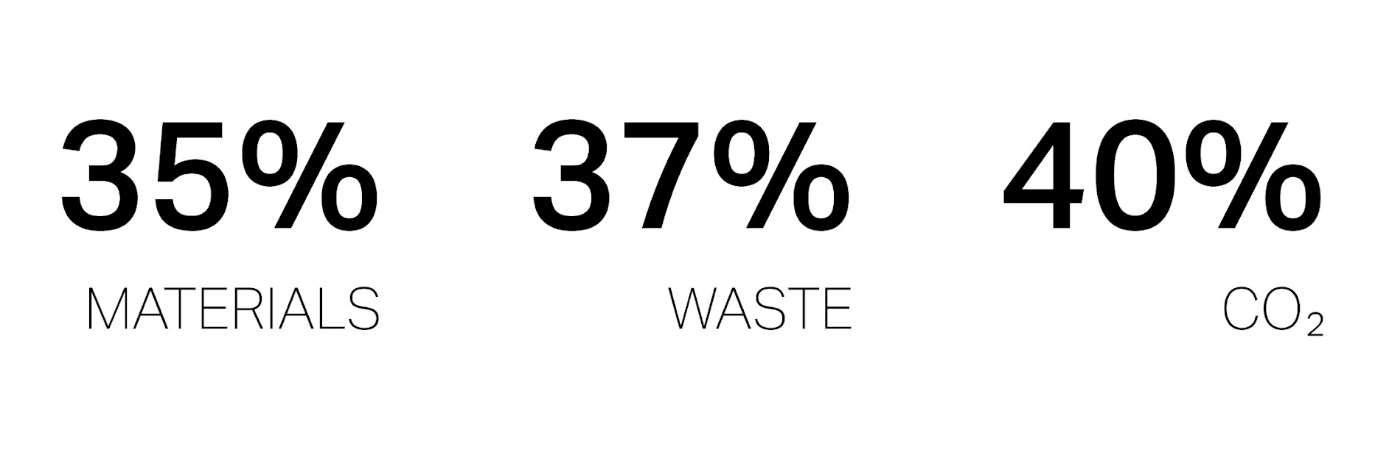
Residential Direct 6%
Transport 23 %
Residential Indirect 11%
Non-resi Direct 3%
Other 6%
Global Industrial CO2 emissions
Non-resi Indirect 8%
Other industry 32 %
Other Construction 11%
Notes:
Graph of global CO2 emissions

Slide 8
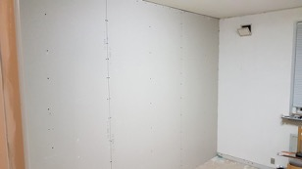
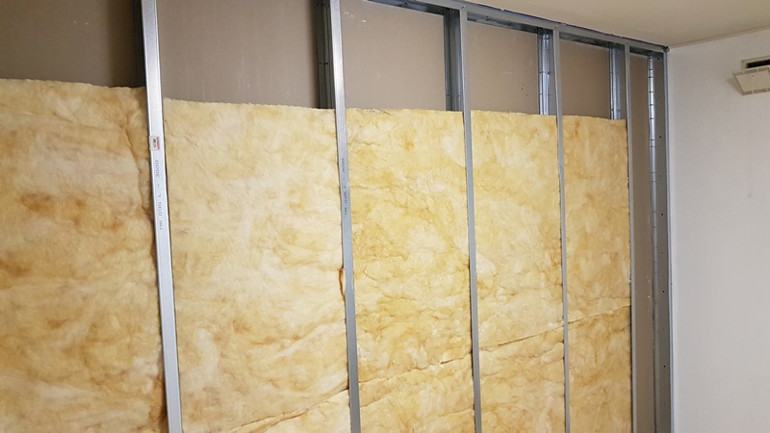
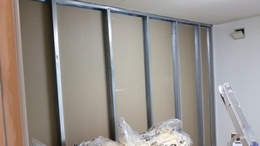
Repairability, reusability and recyclability
The ideal way of disassembly
Notes:
Here’s an example of a classical seperation wall —> Gypsum, aluminimum frames.

Slide 9
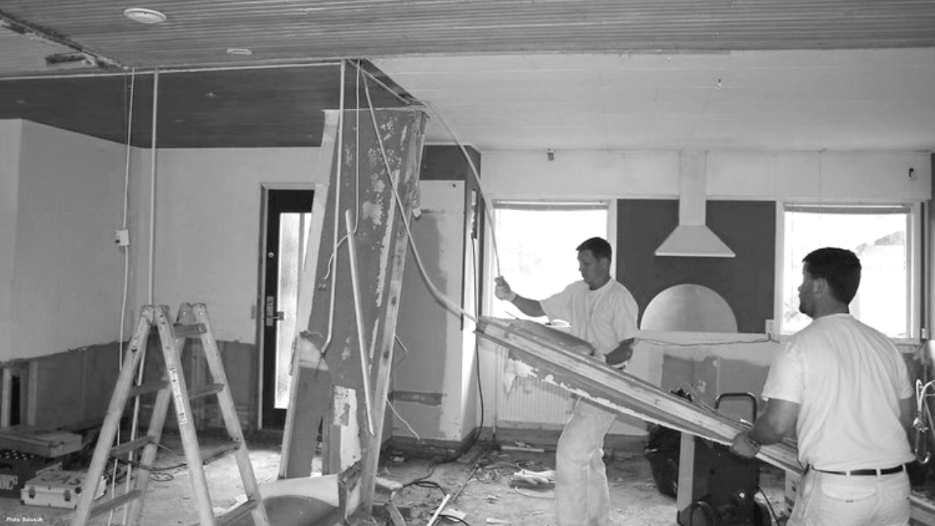
The reality

Slide 10
When designing for circularity everything must be designed for:
Reusability
Repairability
Recyclability
Upgradability
Transformability

Slide 11
CS: WP1 approach to circular design / economy (WILDAU)
About CIRCULAR SPACES and CIRCULAR MAKER EDUCATION TOPIC
Awaiting slides from PP

Slide 12

MAIN PART #1
SESSION 2
Introduction to circular design: design principals, approaches and methods

Slide 13

Circular design principals

Slide 14
Innovation & research
Legislation & regulation
Durability & longevity
Marked demands
Transformation & flexibility
Engagement & consciousness
Circular design
Material selection & exploration
Waste reduction
Upcycle
Resource efficiency and optimization
Local ecosystems
& collaboration
Digitization & data tracking systems
Reuse

Slide 15
Principals / methods
}
disassembly
future transformation and up/down-gradability
honesty (material/parts passport, transparency)
longevity - extended product lifespand
open collaboration
flexible materials
return offerings
Theme 1: REUSABILITY
Theme 2: REPAIRABILITY
Theme 3: RECYCLABILITY
design
for

Slide 16
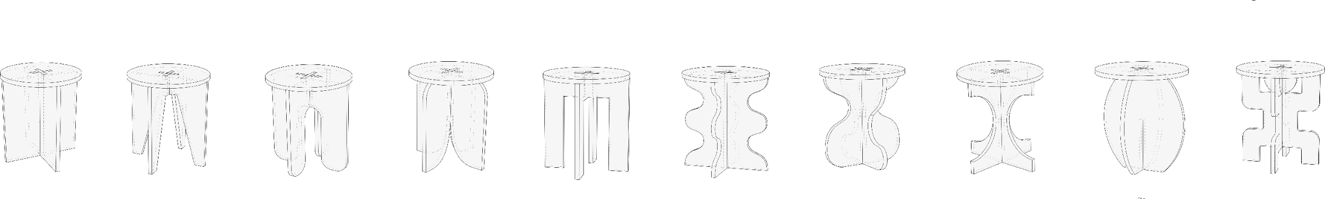
Good practices for reusability, repairability, and recyclability

Slide 17
Design for disassembly, transformation and recyclability
(And flatpack)

Slide 18
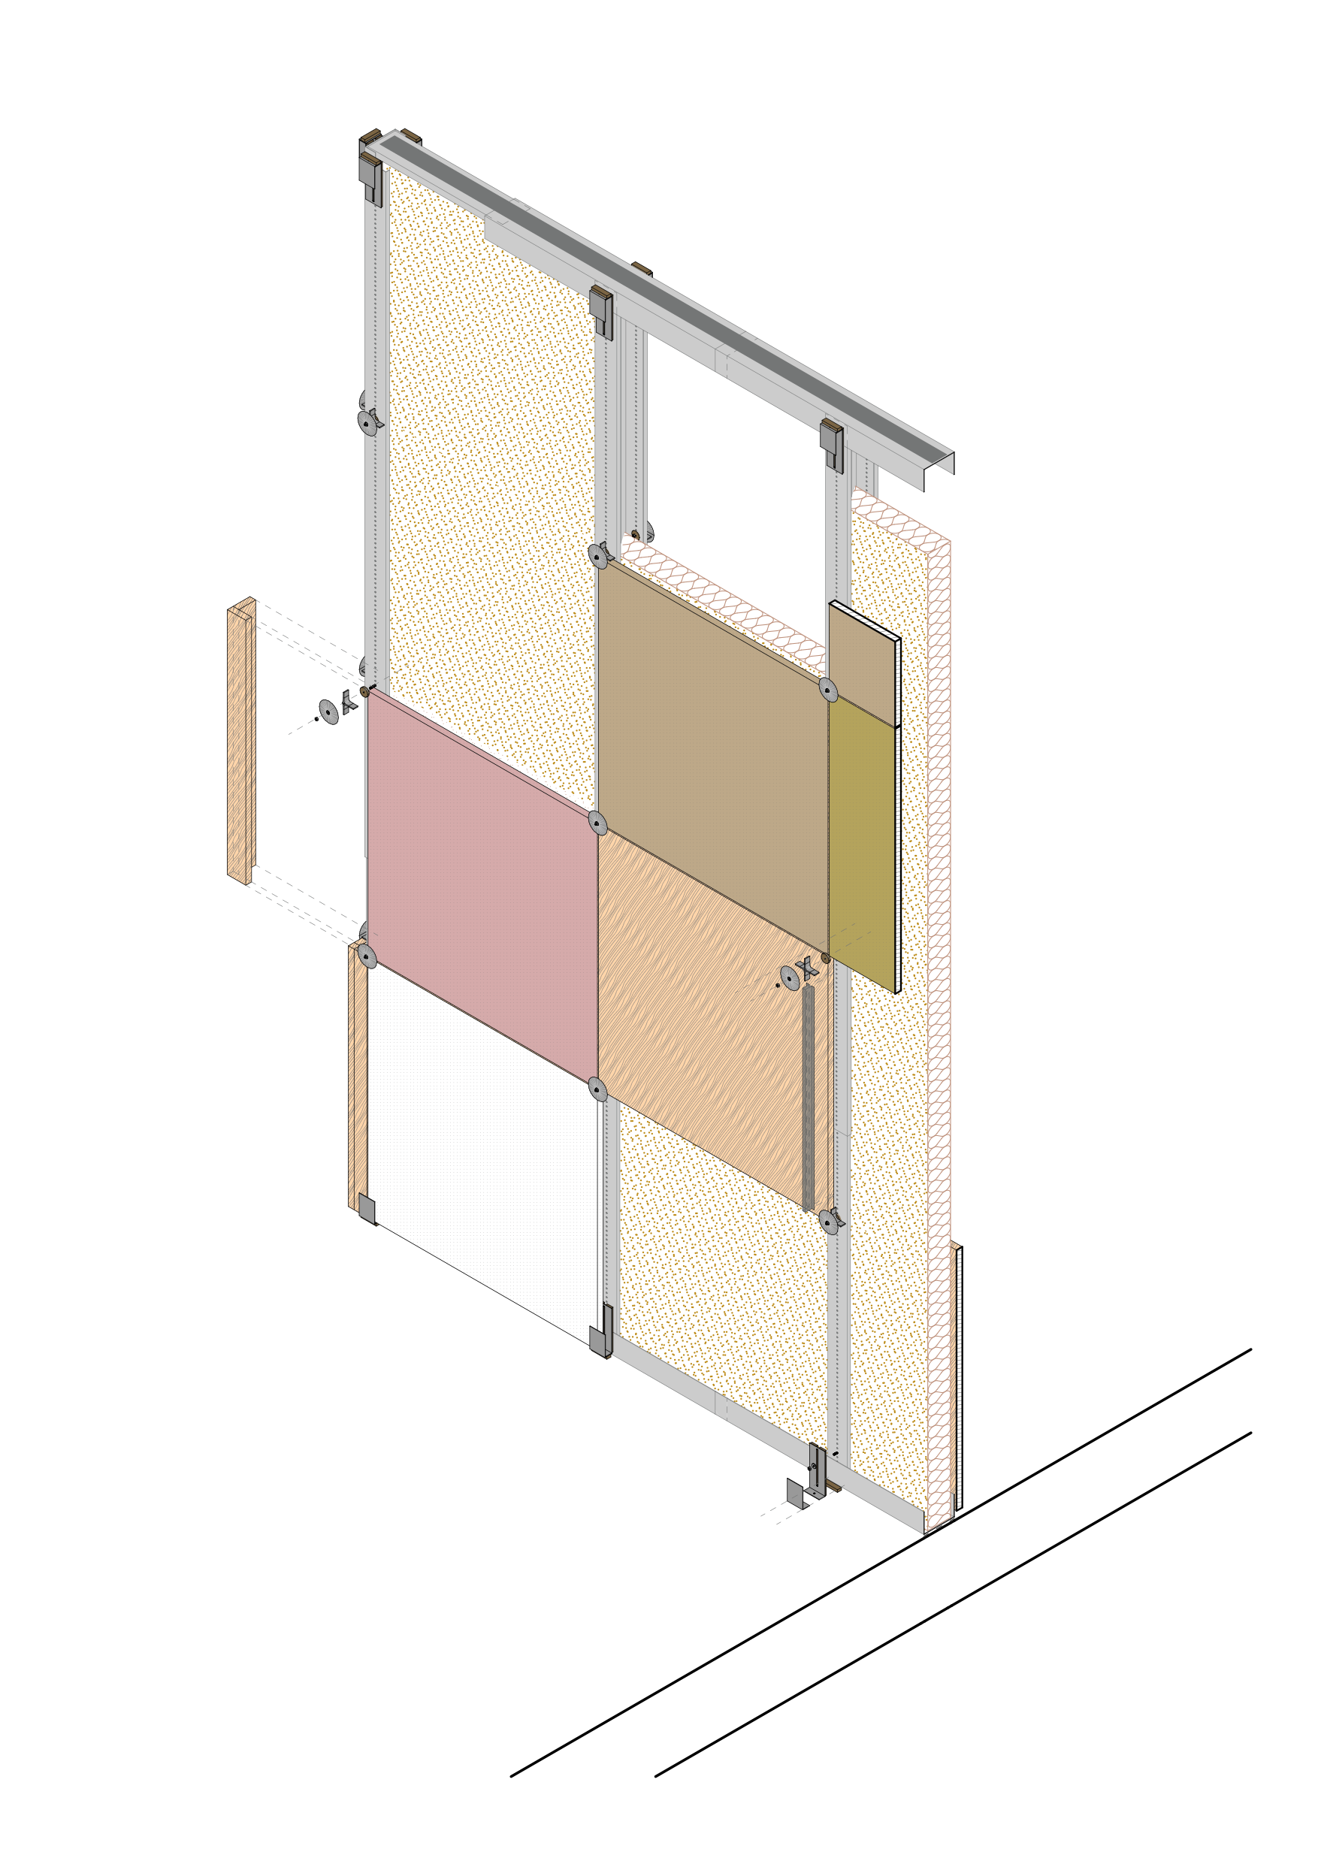
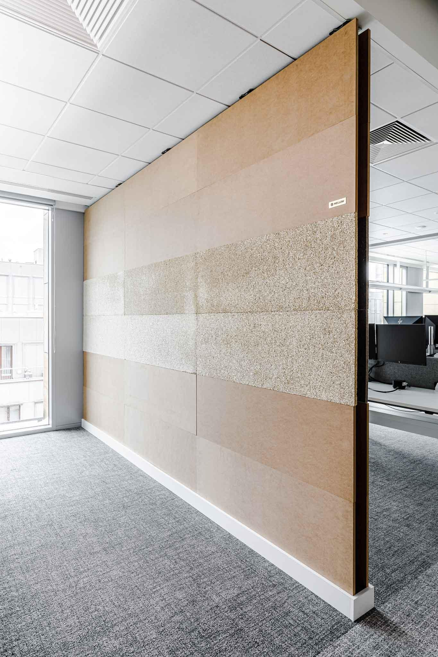
Good practices: Design for Disassembly - from hackathon to business
Plug’N’Wall by Emma Buchanan, Jan Dankmeyer, Katarina Kierulfova & Lukasz Marczuk

Slide 19
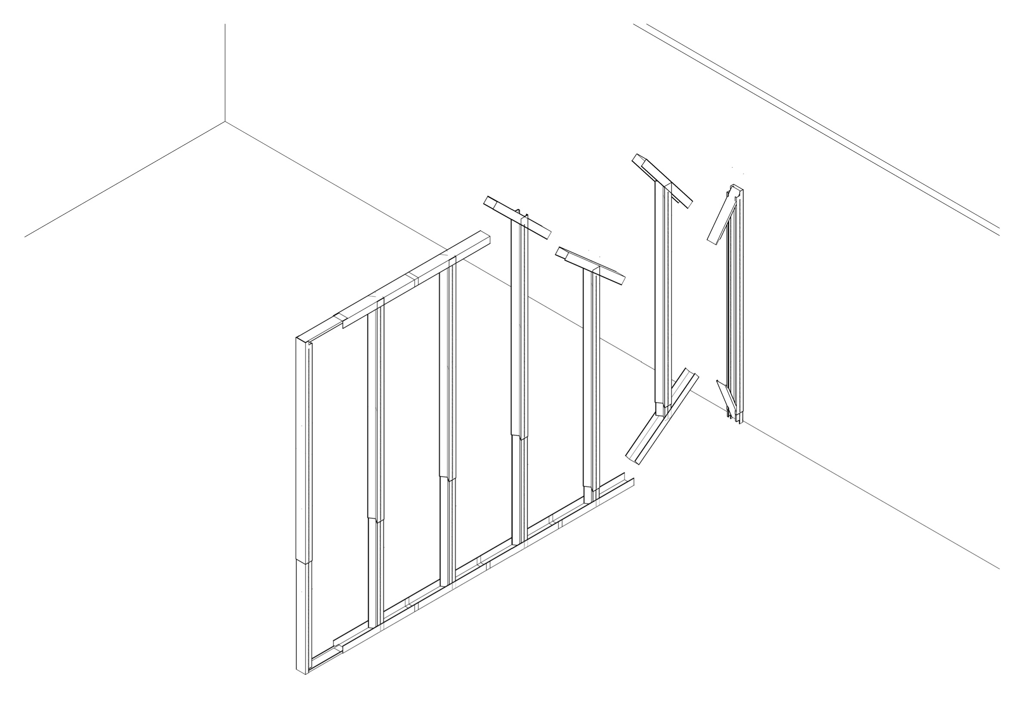

Slide 20
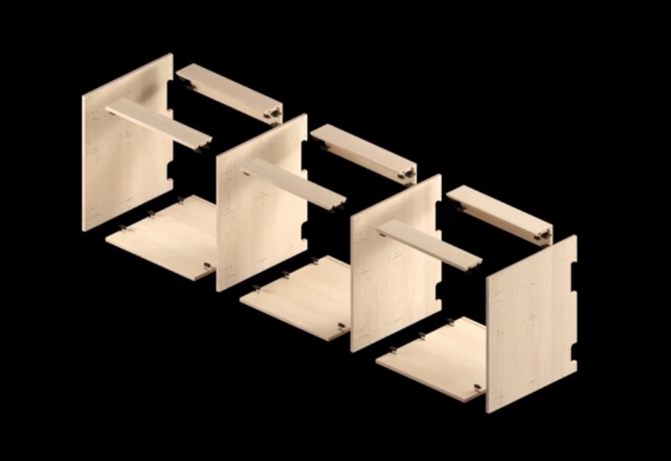
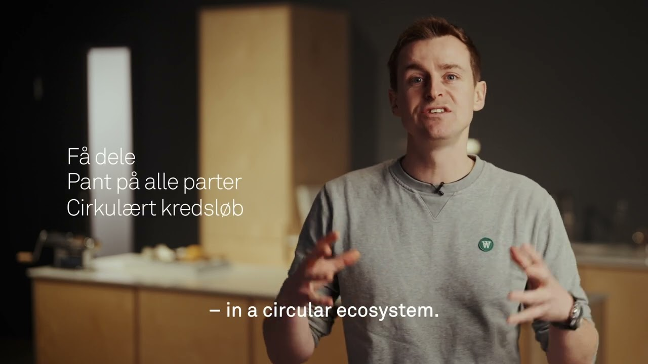
Good practices: Stykka Loop Kitchen
Stykka Explainer

Slide 21
Case: Stykka Loop Kitchen
Material and parts passports and online digital twins ensure traceability, repairability, future upgradability and material transparency for future recyclability
In the field of built-in fixtures, we are among the first to equip our products and parties with QR and RFID, which gives all parties a unique ID. This ensures identification and traceability and helps us keep track of what we have in circulation. The technology connects the physical product with an online digital twin containing product, material and climate data. Traceability is a prerequisite for enabling return logistics in the future, where parts are taken back and prepared for rebuilding. (https://www.stykka.com/cirkularitet)

Slide 22
Case: Stykka Loop Kitchen
DfD
The right joints are a prerequisite for circular products. We assemble all our fixtures with special brackets and cut-outs so that all parts can be easily replaced or repaired.
The joints are part of our modular system, which means that all holes are pre-drilled to avoid drilling during installation, where the risk of damaging a part is greatest. Plus, our installers say it saves them a lot of time. At the end of use, the fixtures can be disassembled, returned and used for new products - without any loss of quality. With screws and dowels in chipboard, this would not be possible. (https://www.stykka.com/cirkularitet)

Slide 23
Case: Stykka Loop Kitchen
Distributed production model - Global collaboration and local production
Technology & carbon footprint
With technology and a digital production method, our goal is to produce locally to minimize transportation and carbon footprint. We see ourselves as part of a global production network, powered by technology, where we send the recipe digitally instead of shopping for tons of materials. (https://www.stykka.com/cirkularitet)

Slide 24

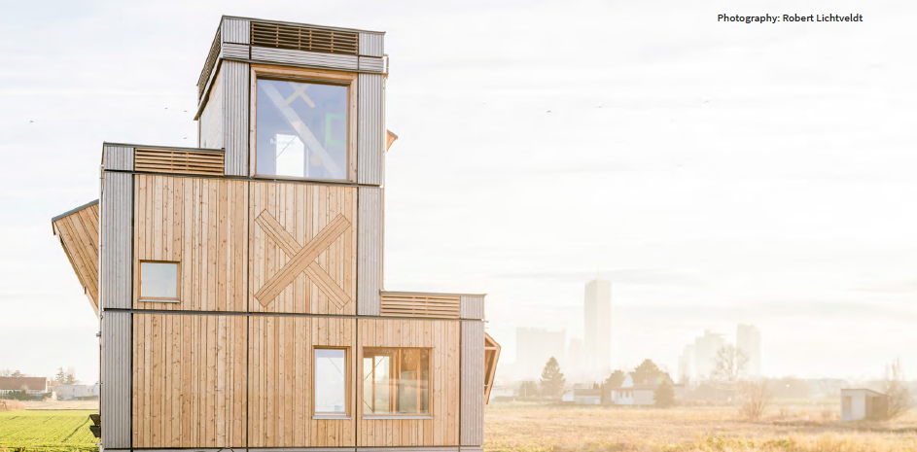
Good practices: Design for Disassembly and flexibility on building scale
Co-creating beautiful ecological buildings.
For hybrid uses and internal flexibility.
At the urban scale.
Based on a reusable modular system.
Consisting of prefabricated elements.
As an inclusive technology for co-creation.
https://www.vivihouse.cc/

Slide 25
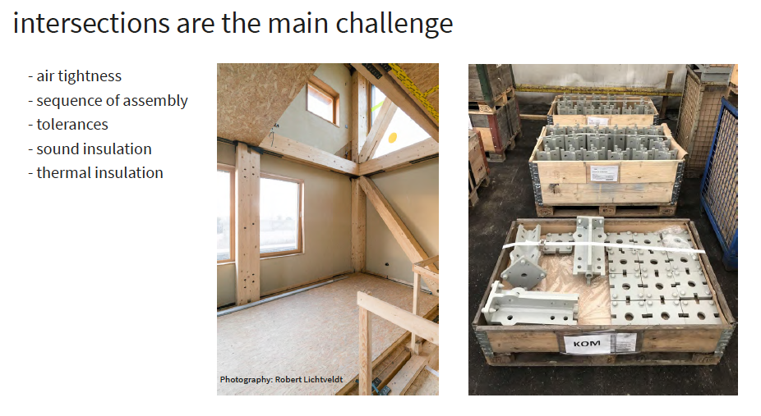
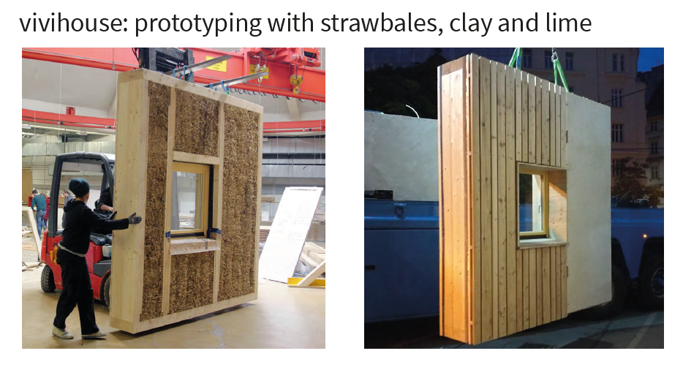
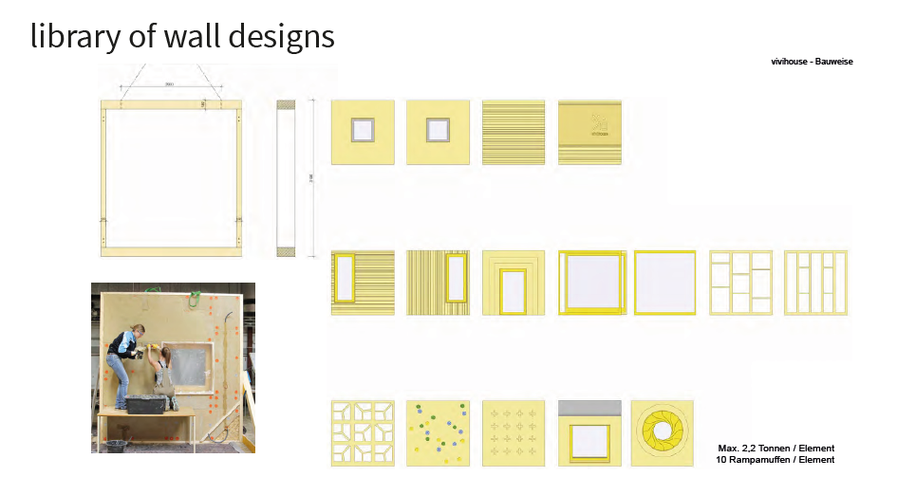
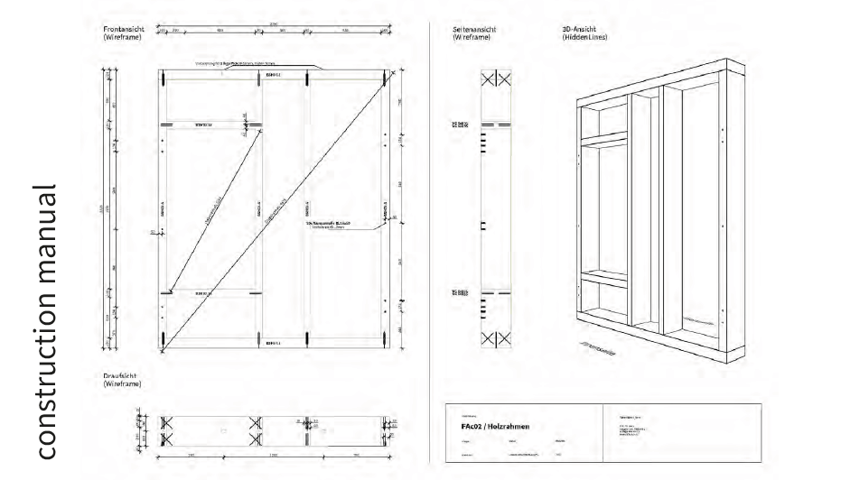
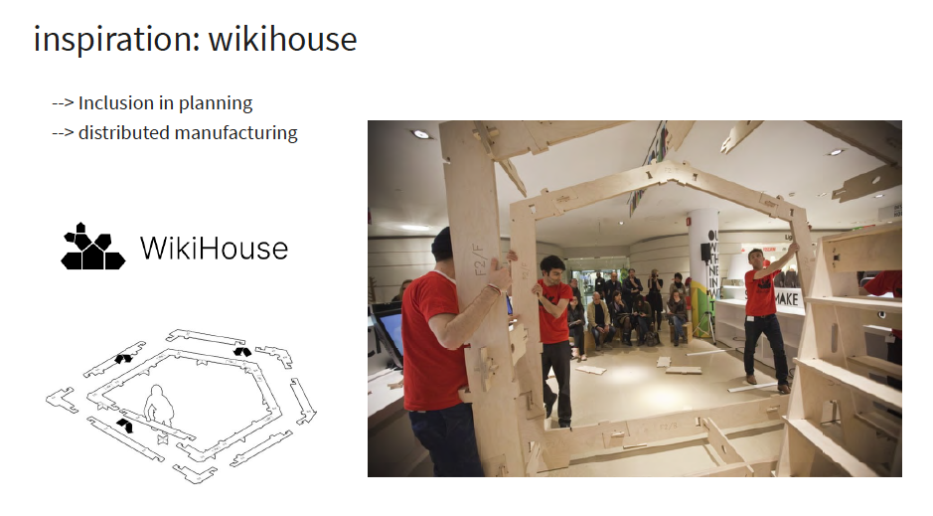
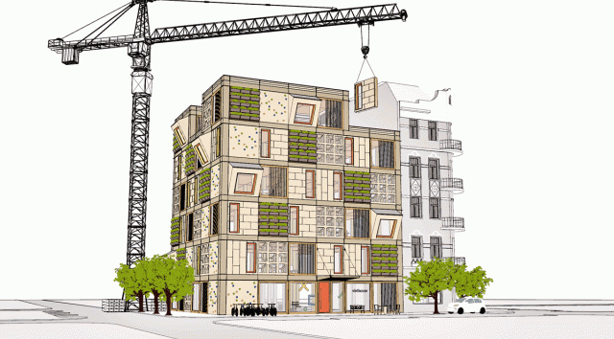
Considerations, DfD and Modularity
Natural materials and circularity
Community and ressources
Open source and sharing
Open source - standing on the shoulders of others
Scalability

Slide 26
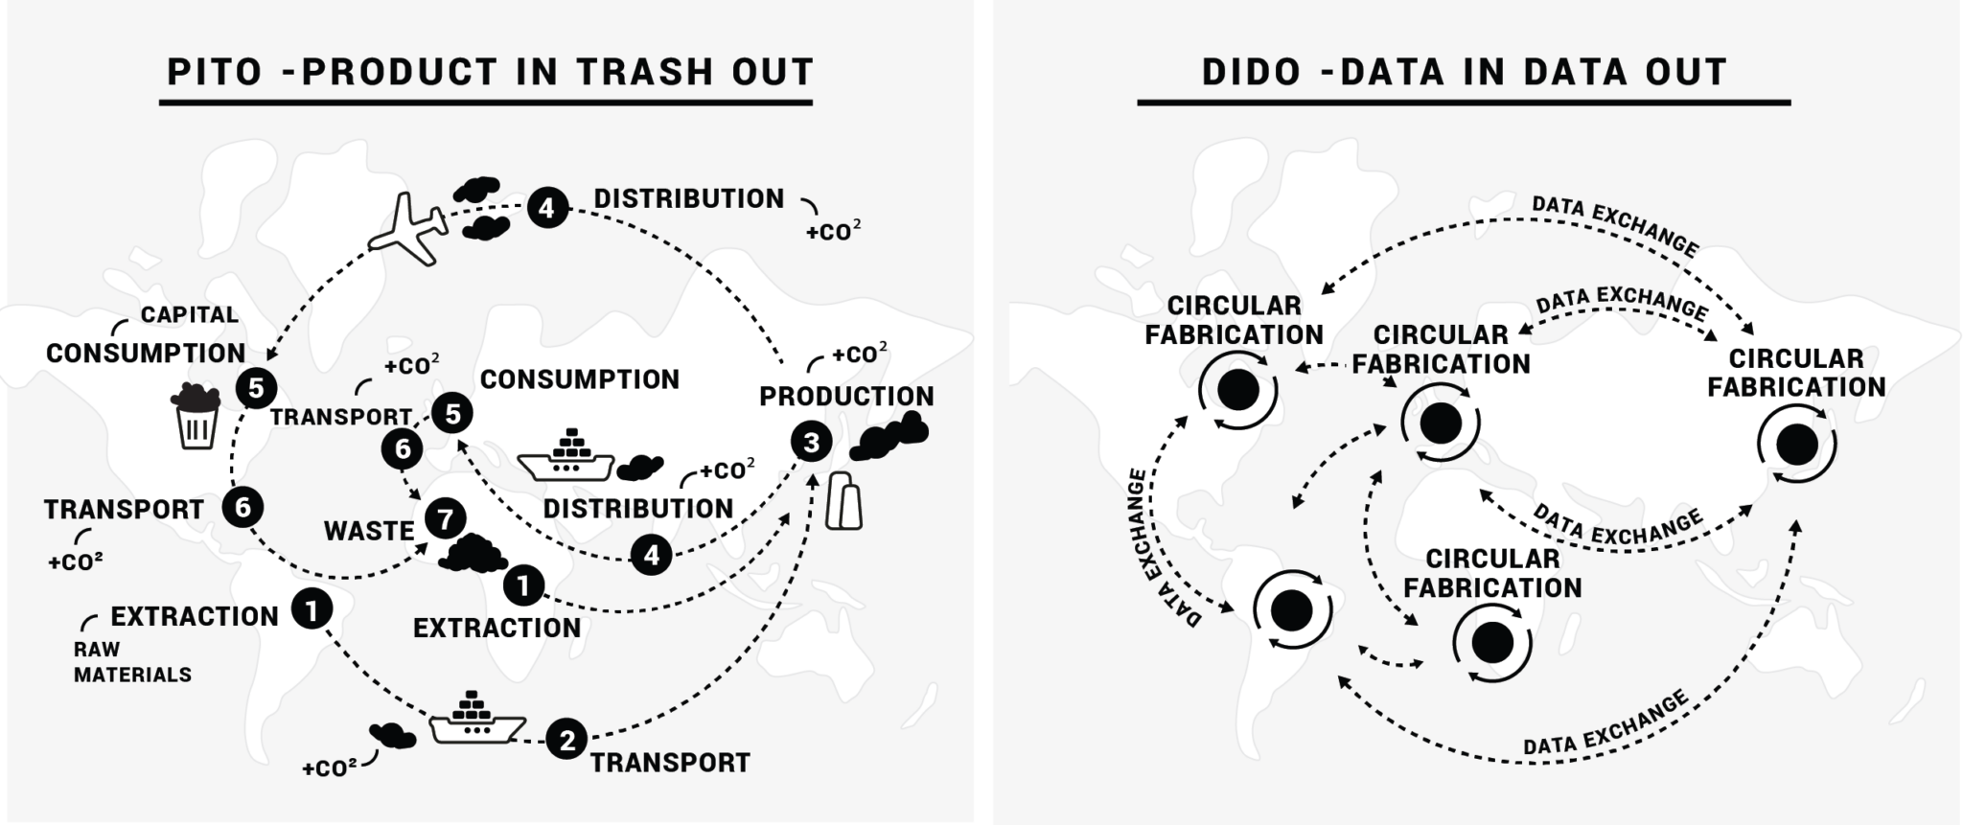



Good practices: Distributed design, open innovation and fab cities
The Distributed Design Platform is an incubator programme targeting the overall mission of Fab Cities and acts as an exchange and networking hub for the european maker movement. The initiative aims at developing and promoting the connection between designers, makers and the market.
PITO TO DITO, Fab City

Slide 27
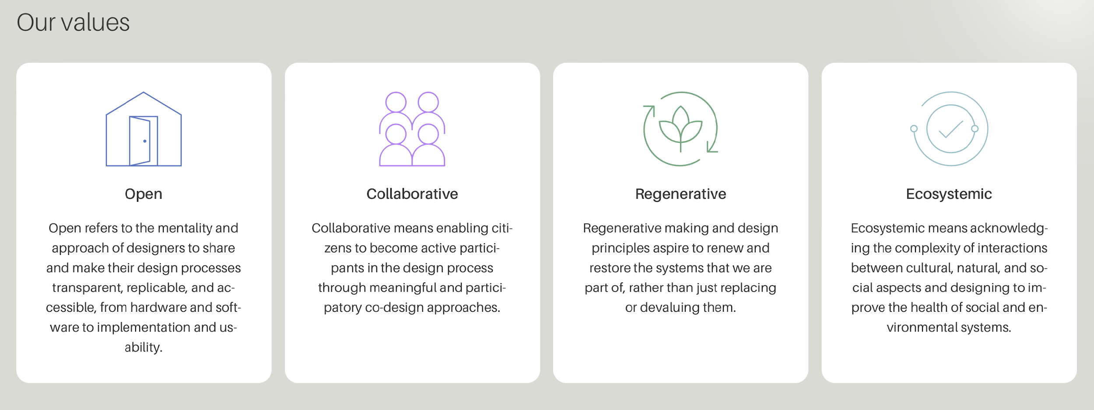
Good practices: Distributed design, open innovation and distributed fabrication
DDP - Values

Slide 28
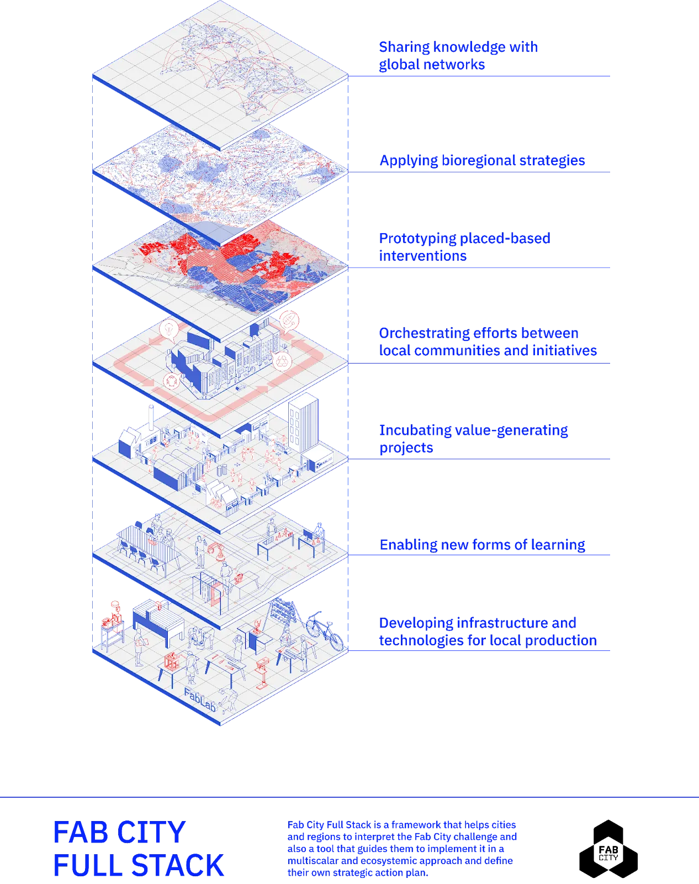
Good practices: Fab cities
FULL STACK MODEL

Slide 29
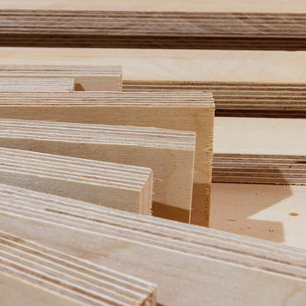
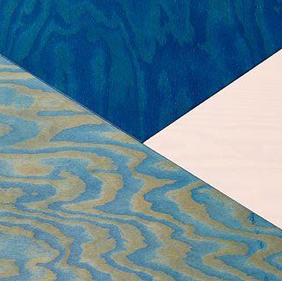
Materials? Decisions, decisions
Organic and natural
Recyclable
Locally sourced
No use of screws or nails

Slide 30
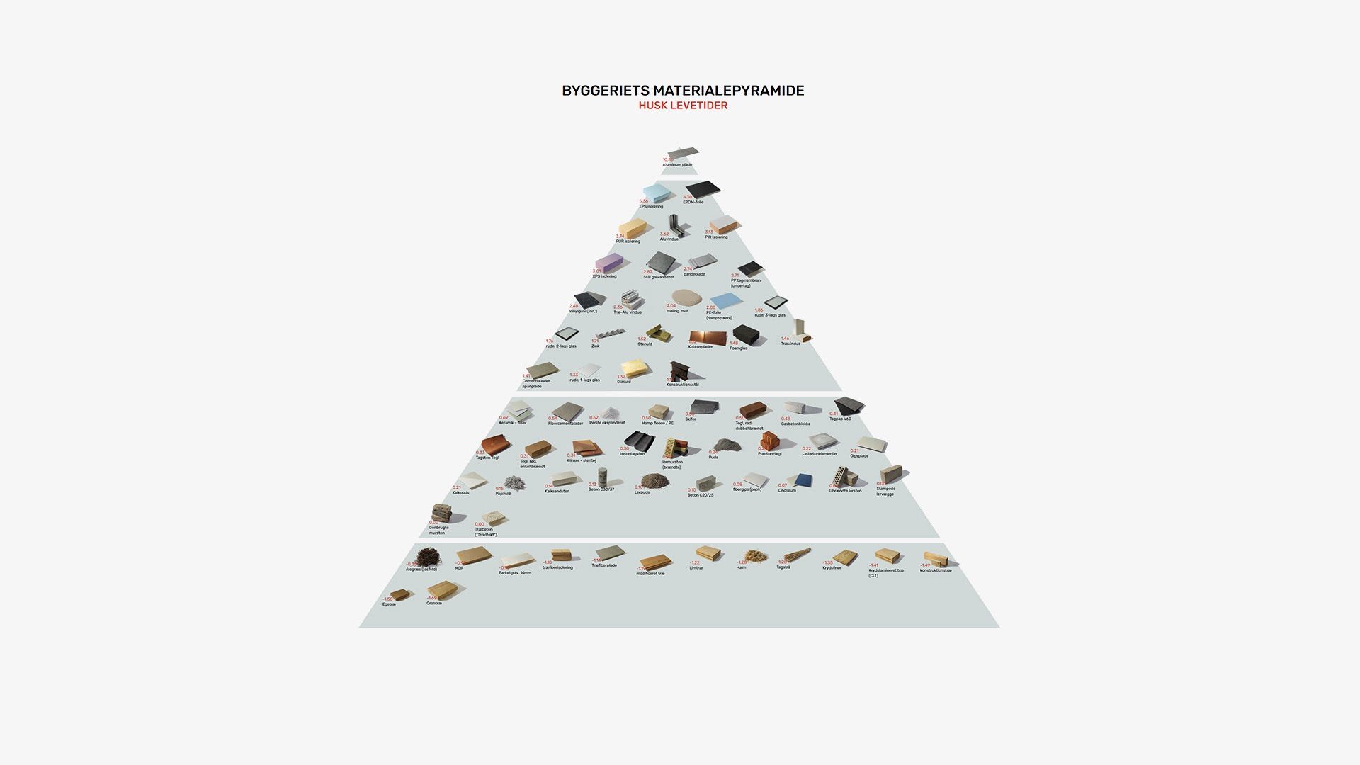
Interactive link to “Materialepyramiden”

Slide 31
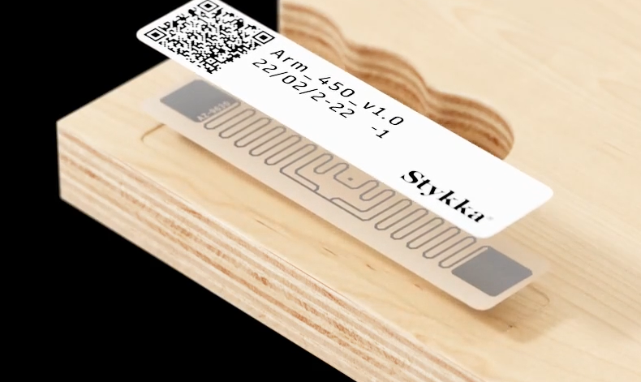
Material and parts passport
RFID and QR codes on all parts ensure traceability and connect the inventory with its digital twin on the operating platform.
This enables repairability, future transformability, recyclability and potentially also opens up for a second hand market of unwanted parts.
Stykka: https://www.stykka.com/teknologi

Slide 32

Durability & longevity

Slide 33

MAIN PART #2
SESSION 3 - Workshop
Kickstarting your circular transition (strategies, value and ecosystems)

Slide 34

Open resources and Circular Toolkit.developed by DDC.
Possibility to do online training and physical workshops using the Circular Toolkit.

Slide 35
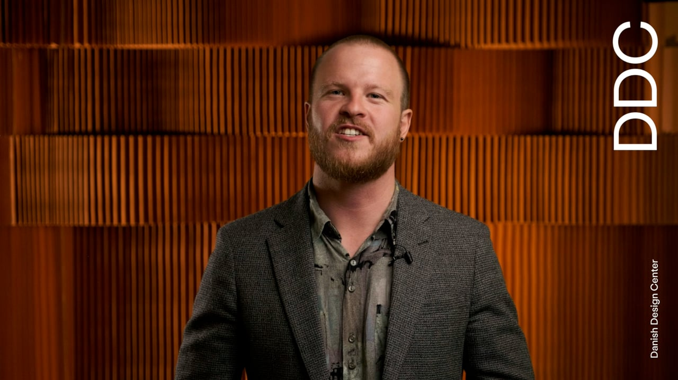
Video introduction to DDC’s Circular Toolkit
https://ddc.dk/tools/designing-your-circular-transition/

Slide 36
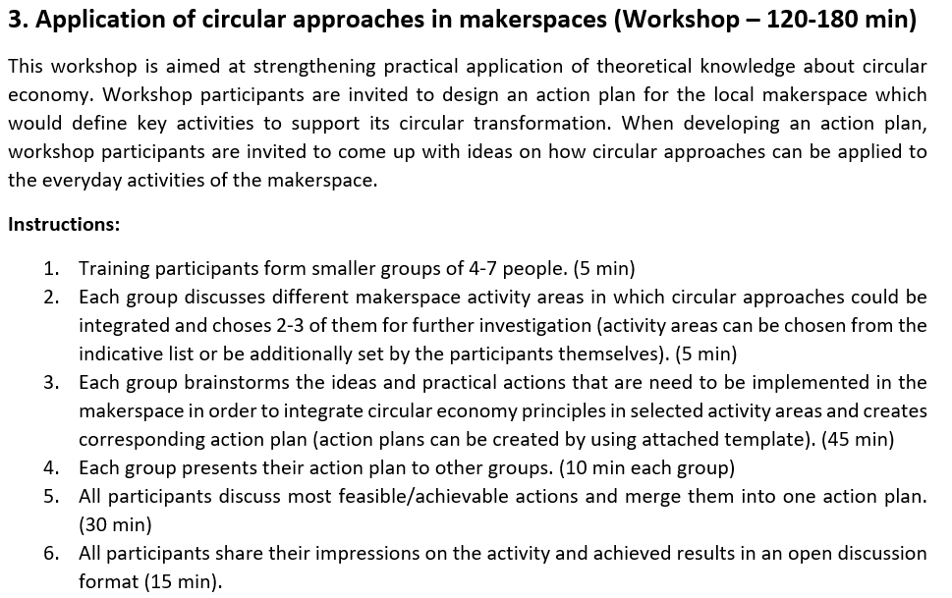
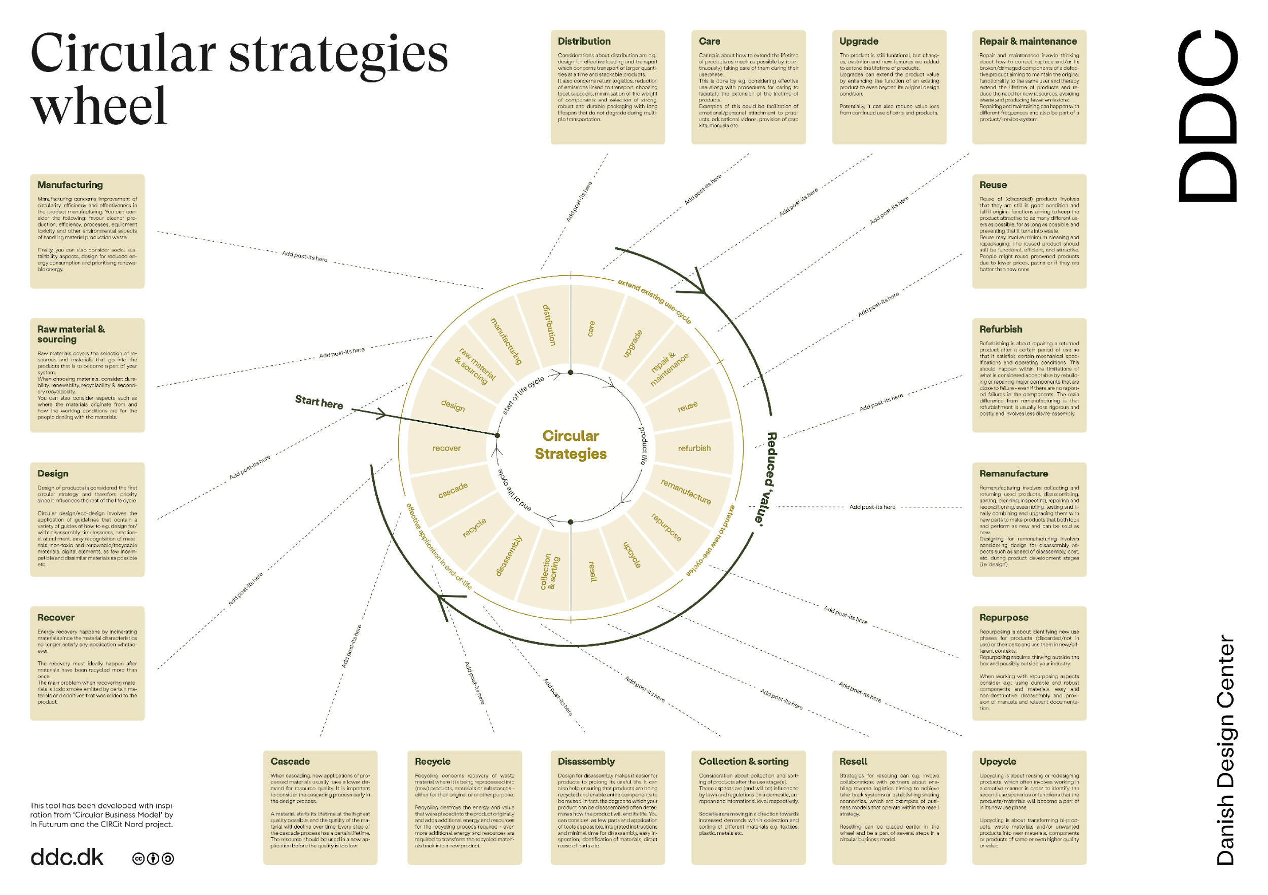
https://ddc.dk/tools/designing-your-circular-transition/

Slide 37
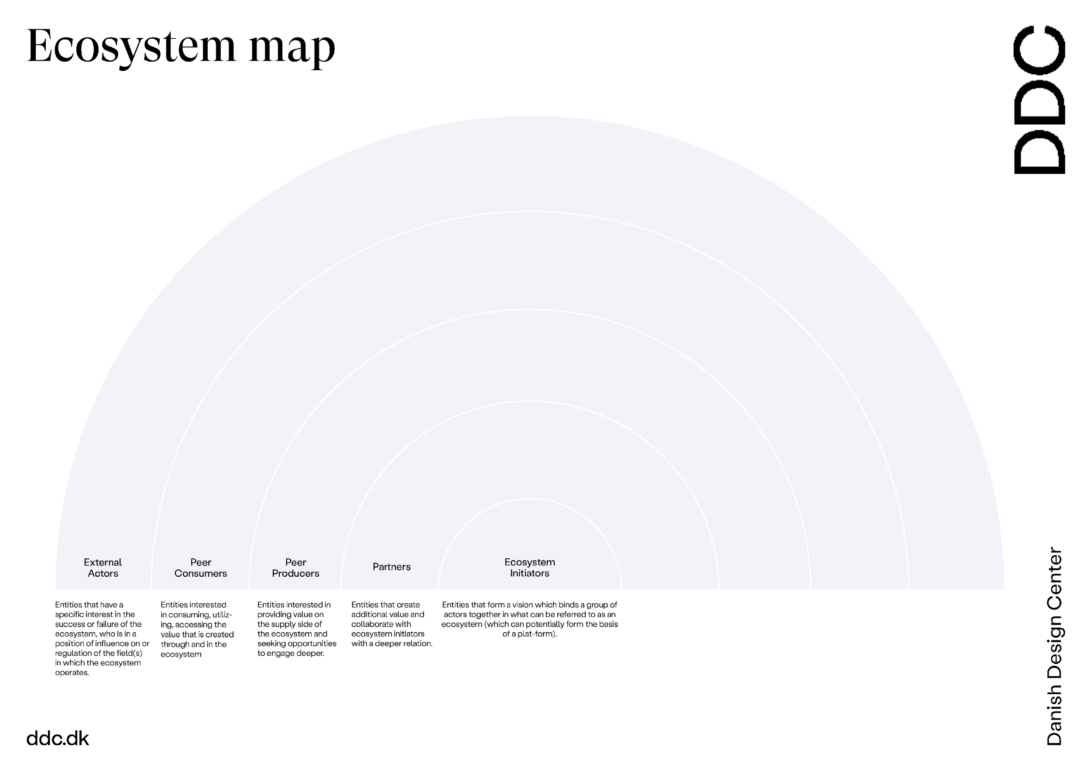
https://ddc.dk/tools/designing-your-circular-transition/

Slide 38
CONCLUSION
SESSION 4
CIRCULAR MAKER tool box of open resources

Slide 39
Platforms and communities for circular makers and makerspaces
WIKIFACTORY
Is a product development platform built for engineers and designed for all extended team members. With no training required, you experience effortless real-time collaboration across teams, fostering efficient communication, streamlined workflows, and accelerated time to market.
DISTRIBUTED DESIGN PLATFORM
The Distributed Design Platform acts as an exchange and networking hub for the emerging field of distributed design. The initiative aims at developing and promoting the connection between designers, makers and emerging digital and local markets.

Slide 40
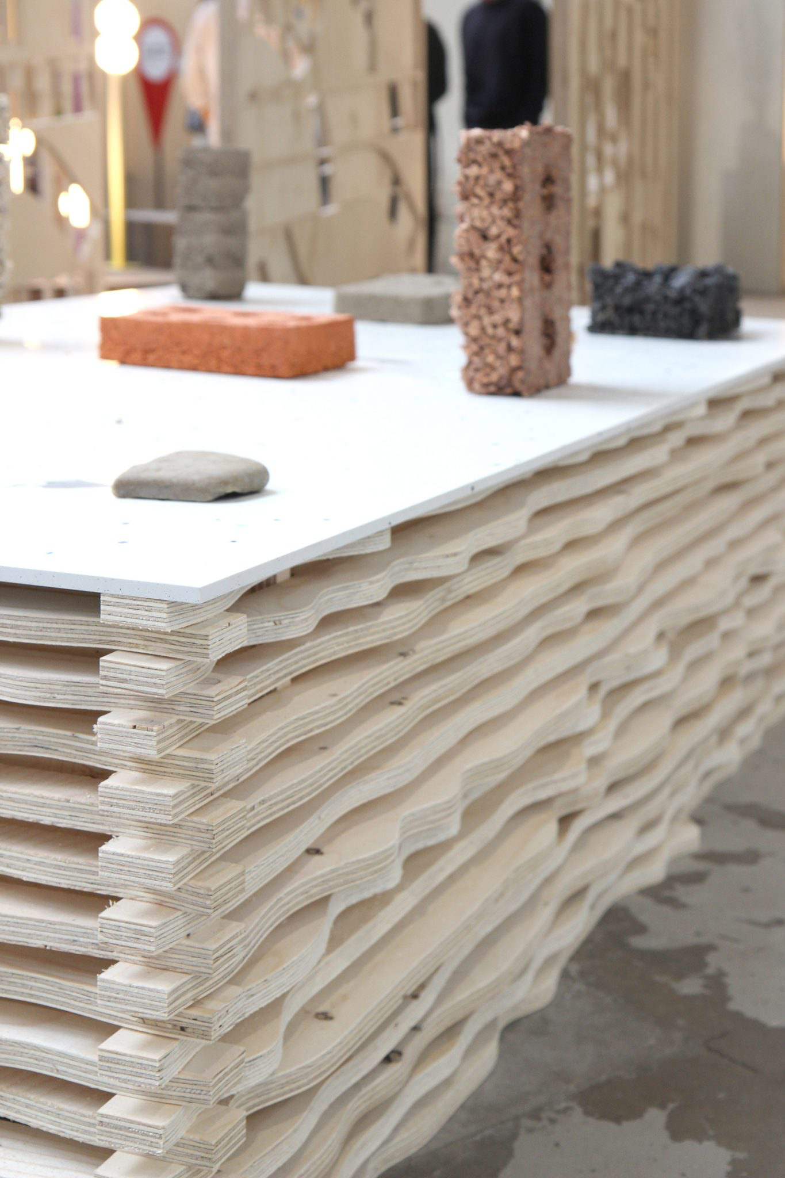
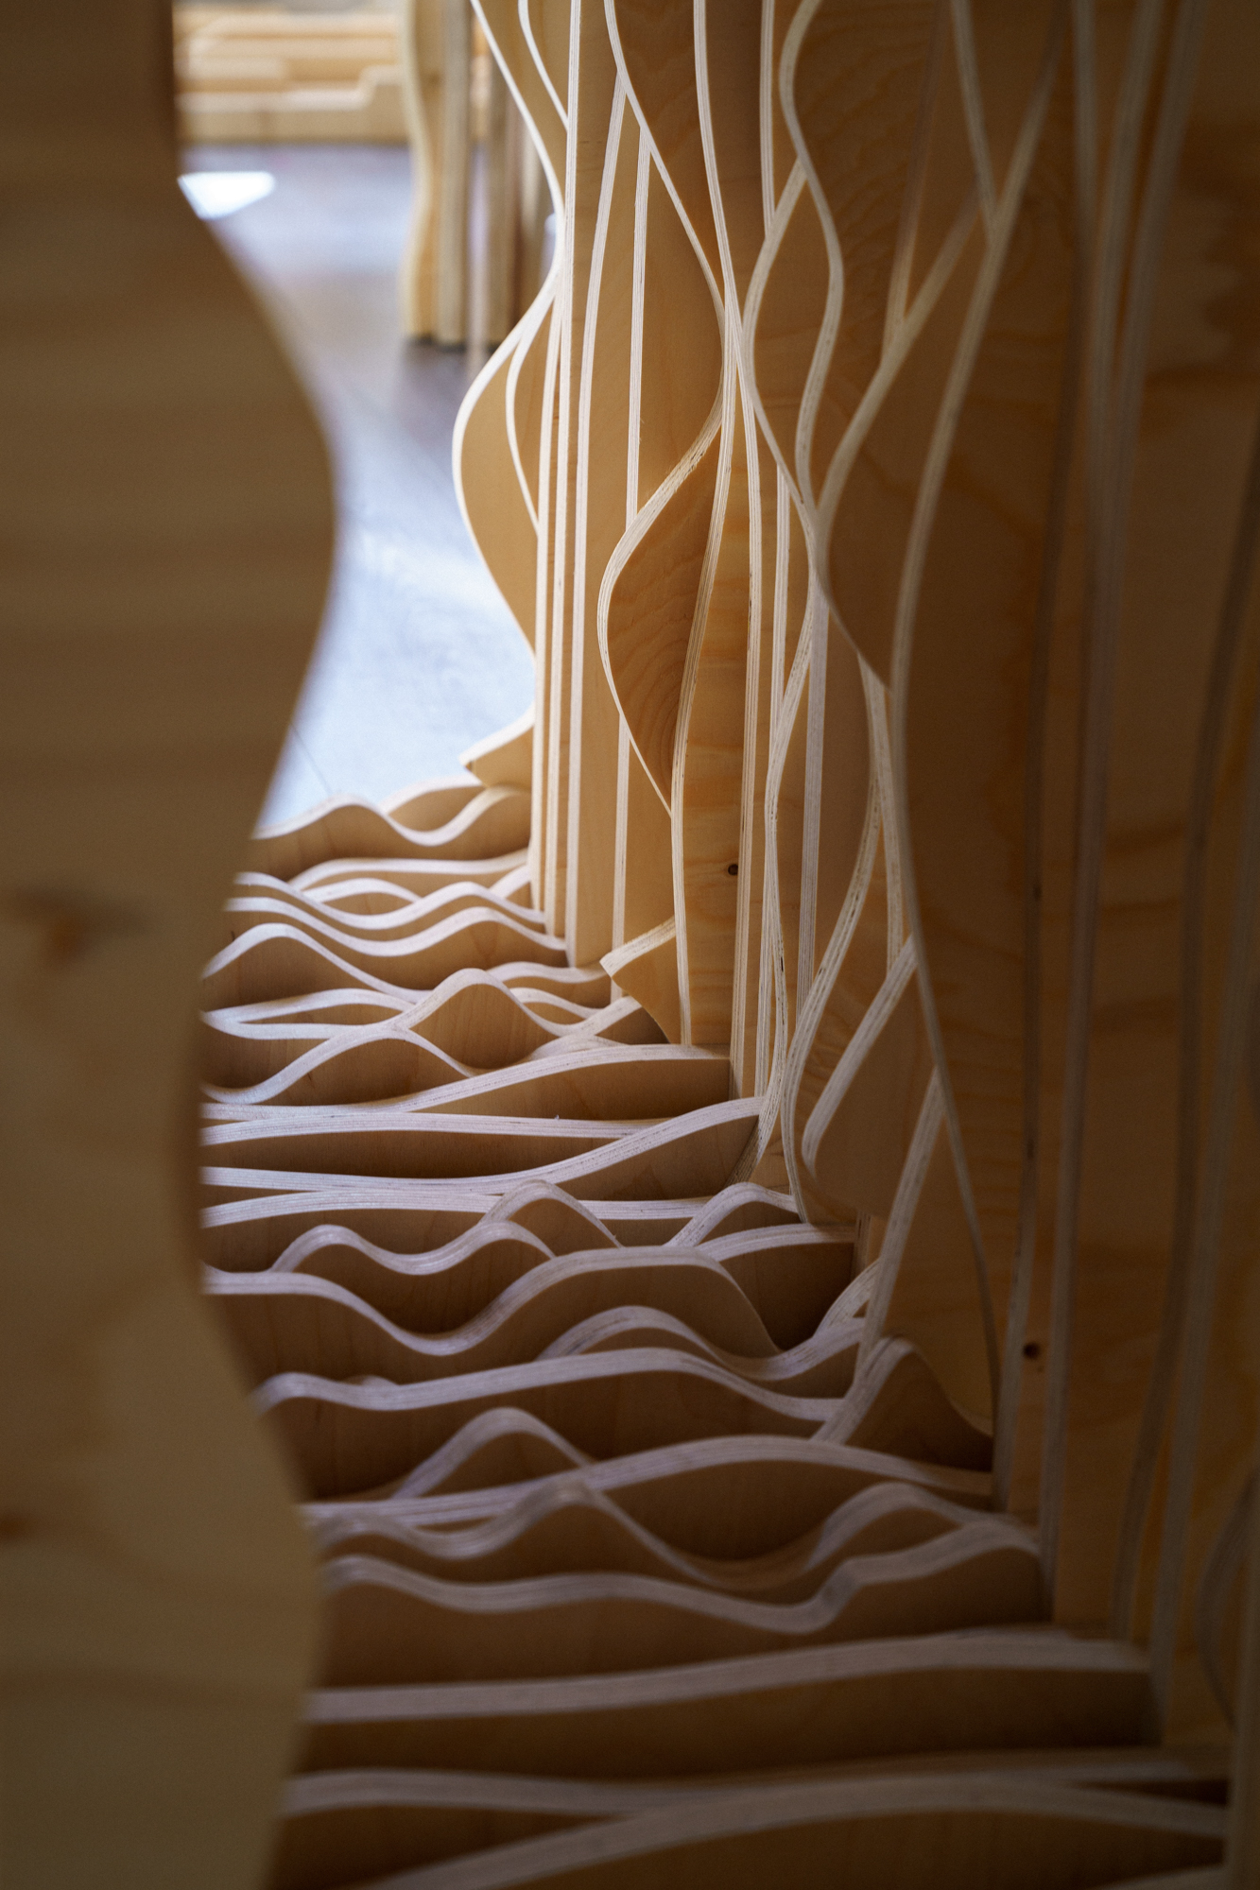
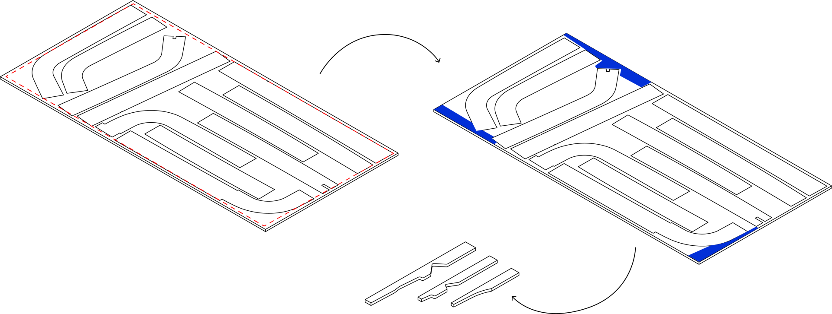
TOOL: Found Objects - Edge Generator
Reusability and recyclability
https://github.com/found-objects/FoundObjects

Slide 41
Open resources for LCAs and material comparisons
OpenLCA
The platform is freely available software for Life Cycle Assessment (LCA) developed by GreenDELTA in Berlin.
BYGGERIETS MATERIALEPYRAMIDE
This website is an online and interactive tool for calculating and comparing the (relative) carbon footprint of various materials.

Slide 42
Open LCA tool and CO2 material calculations developed by CINARK – Center for Industriel Arkitektur, KADK and Vandkunsten
Interactive link to “Materialepyramiden”

Slide 43
New waste materials and platforms
MATERIAL EXCHANGE PORTAL
The Material Reuse Portal brings together construction materials from multiple marketplaces to create a single place where reusable materials can be found. Developed as part of the EU funded project CIRCuIT.
THE UPCYCL
THE UPCYCL is a tool and a catalyst for the utilization of materials - even those with skewed dimensions and unrefined edges.

Slide 44
GENBYG
This website is an online and interactive tool for calculating and comparing the (relative) carbon footprint of various materials.
JJENSEN GENBRUG
This website is an online and interactive tool for calculating and comparing the (relative) carbon footprint of various materials.

Slide 45
What to know more? Check out these articles and websites
https://distributeddesign.eu/how-makers-relate-their-work-to-circularity/
https://distributeddesign.eu/cities-as-distributed-and-decentralized-material-ecosystems-supporting-local-and-circular-production-within-all-sectors/
https://wikifactory.com/+wikifactory/stories/guide-to-design-for-disassembly-how-to-implement-it
https://www.teknologisk.dk/design-for-disassembly-haandbog-om-affaldsforebyggelse-i-byggeriet/40730
https://materialreuseportal.com/
https://wikifactory.com/

