Slide 1
Integrating circular aproaches into every day work life
Topic 8
Training program „Circular makerspaces“
interreg-baltic.eu/project/circular-spaces

Slide 2
Introduction
This training Topic is aimed at facilitating practical application of circular economy-oriented practices into everyday operation of makerspaces.
The following material is designed to guide makerspace communities on how theoretical knowledge about the circular economy can be integrated into existing work routines.
By taking a more proactive approach on circular transformation, makerspaces can not only be more environmentally conscious but also better align their activities with economic efficiency, innovation, and societal expectations.
©Pixabay

Slide 3
Makerspaces are by definition quite circular, as they encourage the sharing of...
... tools
... equipment
... materials
… knowledge
... skills
By turning creative ideas into physical products, makers are well aware of the value of the resources used and the amount of work required for this process. The unique features of makerspaces position them into a favorable setting of mainstreaming circularity ideas even broader.
©Pixabay

Slide 4
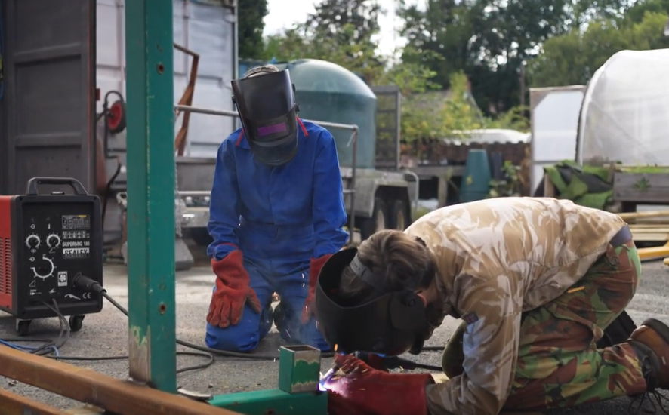
Discussion
See the example of Amman Valley MakerSpace project and discuss the following question.
What are similarities and differences between the Amman Valley MakerSpace and your local makerspace with regards to sharing different resources among the community members:
tools, equipment, and materials?
knowledge and skills?
Notes:
https://www.youtube.com/watch?v=s5Gg_LMbOeI

Slide 5
Previous Topics in this training program provide a wealth of information on different circular economy subjects. In order to unlock the long-term value of this knowledge, this Topic utilizes Bloom’s Taxonomy approach that provides a structured framework both for trainers and trainees to engage with the principles and concepts of circularity. Knowledge capture and the formation of competences and skills are strengthened as progress is made towards the higher steps of the pyramid.
Creating: To produce new circular economy based works
Evaluating: To provide opinion on different circular economy ideas
Analyzing: To form connections among several circular economy ideas
Applying: To use information about circular economy in new contexts
Understanding: To explain circular economy concept and coresponding ideas
Remembering: To recall basic circular economy concept and acompanying principles

Slide 6
Remembering:
Recalling key terms and definitions related to circular economy, such as reduce, reuse, recycle, and upcycling.
Remembering examples of circular practices in various industries.
Understanding:
Explaining the fundamental principles and goals of creating a closed-loop system.
Interpreting the interconnectedness of environmental, social, and economic aspects within the circular economy paradigm.
Applying:
Demonstrating how to implement waste reduction strategies in practical scenarios.
Applying circular thinking to design projects, considering the lifecycle and end-of-life aspects of materials.
Creating: To produce new circular economy based works
Evaluating: To provide opinion on different circular economy ideas
Analyzing: To form connections among several circular economy ideas
Applying: To use information about circular economy in new contexts
Understanding: To explain circular economy concept and coresponding ideas
Remembering: To recall basic circular economy concept and acompanying principles

Slide 7
Analyzing:
Analyzing case studies or real-world examples of businesses or communities successfully implementing circular practices.
Breaking down the components of a product or system to evaluate its potential for circularity.
Evaluating:
Assessing the effectiveness of different circularity initiatives or circular business models.
Evaluating the environmental and social impact of various circular practices.
Creating:
Applying knowledge to create innovative solutions that embody circular economy principles.
Developing new products, services, or systems that prioritize sustainability, circularity, and responsible resource management.
Creating: To produce new circular economy based works
Evaluating: To provide opinion on different circular economy ideas
Analyzing: To form connections among several circular economy ideas
Applying: To use information about circular economy in new contexts
Understanding: To explain circular economy concept and coresponding ideas
Remembering: To recall basic circular economy concept and acompanying principles

Slide 8
Discussion and self-reflection
Based on this Taxonomy, the integration of circular approaches in everyday work life depends on the individual's (or organisation's) ability to apply the knowledge in different settings. For example, when analysing the organisation's activities, setting new goals or evaluating existing initiatives, all related to mainstreaming circular economy approaches.
Based on your experiences and understanding of different circular economy ideas, where would you place yourself in Bloom’s Taxonomy pyramid? Why?
What further actions, resources or assistance are needed for you to advance further towards the higher steps of the pyramid? How can makerspace community support your advancement?
Creating: To produce new circular economy based works
Evaluating: To provide opinion on different circular economy ideas
Analyzing: To form connections among several circular economy ideas
Applying: To use information about circular economy in new contexts
Understanding: To explain circular economy concept and coresponding ideas
Remembering: To recall basic circular economy concept and acompanying principles
©Pixabay

Slide 9
Circular approaches
What is meant by circular approaches?
In a general sense, it is the application of knowledge about the circular economy to the different decision-making processes. These processes can range from the simplest and routine, such as proper sorting of packaging or use of public transport, to the highly complex or large-scale, such as designing a new product or developing a sustainable business strategy.
When we adopt circular approaches, we look at our actions through the lens of the circular economy, in addition to other considerations. This can be simplified to the question of "How can I reduce resource consumption and waste generation through this action?"
©Pixabay

Slide 10
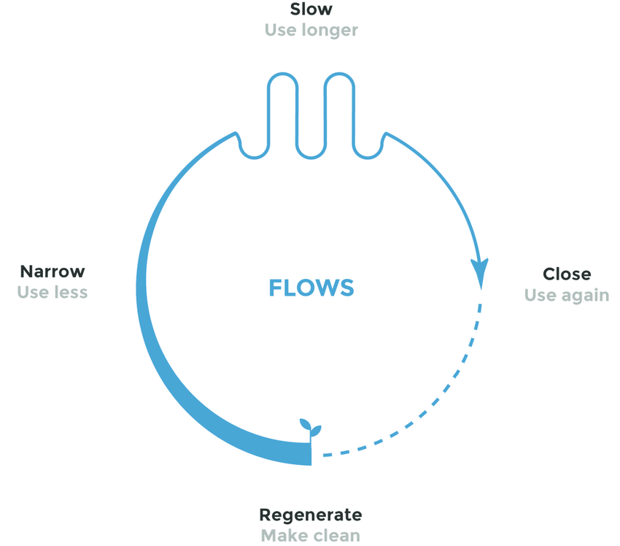
Circular approaches are inseparable part of circular behavior which utilizes the rationale of responsible resource consumption.
A more systemic viewpoint to circular consumption, introduced by Circle Economy Foundation, refers to 4 resource use strategies:
slowing flows
closing flows
narrowing flows
regenerating flows
Examples of consumer‘s or user‘s actions to...
...slow resouce flows:
careful treatment, regular cleaning, and necessary repairing of products
...narrow resource flows:
participation in sharing and rental models, and avoidance of unnecessary purchases
…close resource flows:
passing on of pre-owned products to others, separation of waste materials
…regenerate resource flows:
use of renewable energy, selection of organic food and toxic-free products
Circular consumption model by Circle Economy @ https://www.circle-economy.com/blogs/circular-consumption-in-the-linear-economy-only-a-drop-in-the-ocean
©Pixabay

Slide 11
Discussion
Usually, when we consider buying a new phone, our decision is based on economic (e.g., price) and technical factors (e.g., battery life, camera resolution). With the adoption of circular approach, we would also question the overall need for a „new“ phone and evaluate the option of buying a refurbished one.
What other aspects, based on your current knowledge about circular economy, could be included into the decision-making of buying a phone?
©Pixabay

Slide 12
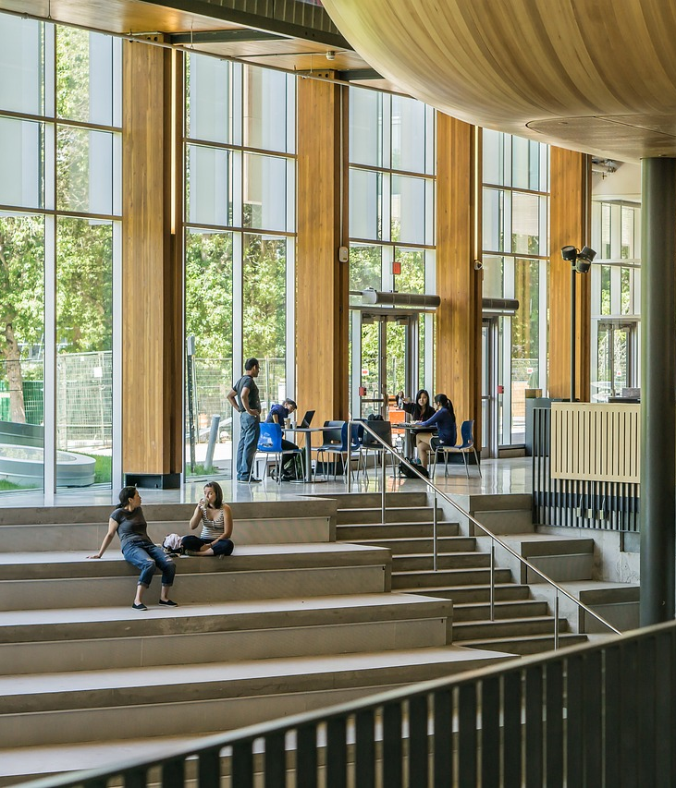
Circular approaches can be adopted not only on an individual level but also on the organizational. Usually, it happens when a group of managing staff agrees on common circular economy-oriented actions, contribute to them with allocated resources, and advocate them to others. This process can be approached by both top-to-bottom and bottom-to-top initiatives. In organizations, circular approaches can be integrated into almost all activities. Examples in the following slides reflect only a fraction of the variety of such possibilities.
©Pixabay

Slide 13
Application of circular approaches on the organizational level:
Procurement example
Implementation of green and circular procurement by incorporating sustainability criteria into the technical requirements of procured goods, services, or works.
Identification of more sustainable and circular product alternatives to be procured by implementing corresponding market analysis.
Reinforcement of effective green and circular procurement implementation by strengthening procurement staff competences.
Reinforcement of the procurement role for contributing to circular economy objectives by aligning it with other organizational agendas, regulations, or strategies.
©Pixabay

Slide 14
Application of circular approaches on the organizational level:
Event example
Implementation of zero-waste events by eliminating single use items, such as packaging, printed agendas, name cards, etc.
Compliance with proper waste sorting by allocating separate recycling bins for different types of waste and by displaying correct sorting information.
Avoidance of event-specific item production, e.g., stationery, banners, souvenirs, etc., by utilizing multiple use alternatives.
©Pixabay
©Pixabay

Slide 15
Application of circular approaches on the
organizational level:
Mobility example
Promotion of shared mobility (e.g., carpooling) by identifying such possibilities among the staff.
Promotion of use of public transportation by creating motivational incentives.
Promotion of use of cycling by allocating parking space for bikes.
Awareness creation regarding environmental impacts of mobility by mainstreaming GHG calculations (example of GHG calculation tool) and setting related reduction goals in the organization.
Promotion of sustainable mobility options for staff travelling to external events by creating corresponding guidelines and recommendations.
©Pixabay
©Pixabay

Slide 16
Some of provided examples not only relate to the circular economy, but also to other concepts such as sustainability or zero-waste. Nevertheless, they all share the objective of using available resources more efficiently, while reducing waste and contributing to lower pollution.
Makerspaces, in this respect, can integrate circular approaches not only in common organizational activities (e.g., procurement, facilities management, etc.) but also into their other typical activities (e.g., production of prototypes, education, etc.). The broader part of makerspace‘s community is involved in the application of circular economy-oriented practices, the greater the environmental impact that can be achieved.
©Pixabay
©Pixabay

Slide 17
Case analysis
“CircularSpaces” makerspace is a dynamic hub for innovators and creators committed to integrating sustainable practices into their projects. The makerspace is planning to initiate a challenge to encourage its community members to apply circular economy thinking to their projects. The challenge will include the creation of furniture design and participants will be tasked to design innovative and functional pieces.
Imagine that you are one of the organisers who have to set the evaluation criteria for the presented projects and choose the winner for the most well thought circular furniture. Define these evaluation criteria both from the design and production, as well as the end user perspectives. Use references or examples from other Topics of this training programme, utilize circular consumption framework provided on slide 10, and apply your overall knowledge of circular economy.
©Pixabay
©Pixabay

Slide 18
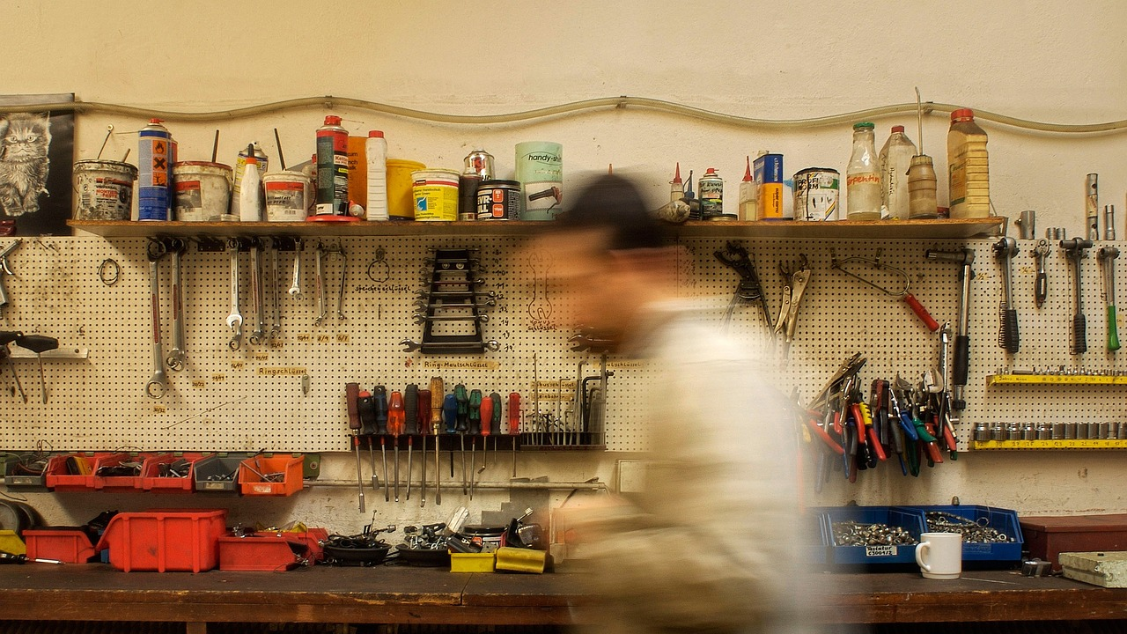
Application of circular approaches in makerspaces
Workshop
©Pixabay

Slide 19
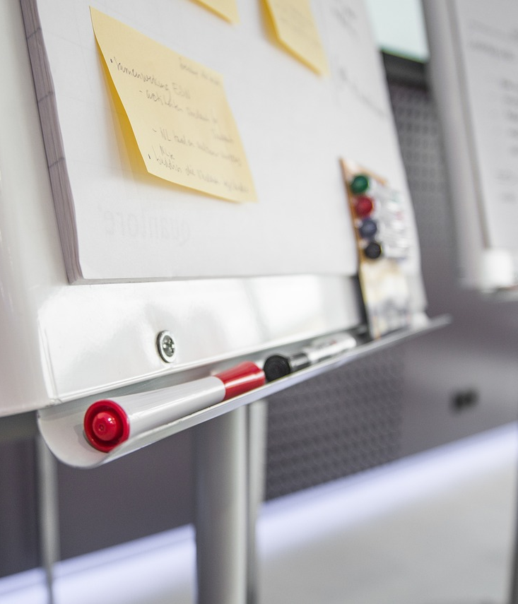
This workshop is aimed at strengthening practical application of theoretical knowledge about circular economy. Workshop participants are invited to design an action plan for the local makerspace which would define key activities to support its circular transformation. When developing an action plan, workshop participants are invited to come up with ideas on how circular approaches can be applied to the everyday activities of the makerspace.
©Pixabay

Slide 20
Instructions
Training participants form smaller groups of 4-7 people. (5 min)
Each group discusses different makerspace activity areas in which circular approaches could be integrated and choses 2-3 of them for further investigation (activity areas can be chosen from the indicative list or be additionally set by the participants themselves). (5 min)
Each group brainstorms the ideas and practical actions that are needed to be implemented in the makerspace in order to integrate circular economy principles in selected activity areas and creates corresponding action plan (action plans can be created by using attached template). (45 min)
Each group presents their action plan to other groups. (10 min each group)
All participants discuss most feasible/achievable actions and merge them into one action plan. (30 min)
All participants share their impressions on the activity and achieved results in an open discussion format (15 min).

Slide 21
Workshop resources
Indicative lists of makerspace’s areas of activities
Prototyping and fabrication (can be narrowed down to different materials/technologies, e.g., electronics and robotics, metalworking, woodworking, audio and video production, etc.)
Education and training
Sourcing of materials, tools, and equipment
Community events
Cooperation with other organizations
Administration and communication
Facility and equipment management

Slide 22
Workshop resources
Template for the action plan
Activity area | Suggested action | Required resources for action implementation | Action implementation timeline | Action objective and measurable result (impact) | Procedures to evaluate achieved impact
E.g., Education and training | Creation of a brief circular design guideline to be used by makers | Human resources (1-2 people) for guideline creation + printing or digital display of prepared material | Guideline creation and selection of its display locations: 2 months Guideline disclosure for makers: perpetually after 2 months | To raise awareness of makers about circular design concept and to promote its application in product design (after 6 months of guideline display at least 80% of makers will know about this concept and at least 50% of makers will have been tried to apply it to their product design) | Survey of makers

Slide 23
Continuous improvement
Incorporating circular approaches into makerspaces can be effectively implemented through the Plan-Do-Check-Act (PDCA) approach, fostering a continuous cycle of improvement.
Embracing the PDCA approach ensures a dynamic and iterative process, fostering a culture of continuous improvement and sustainability within makerspaces.
Act
Plan
Check
Do
©Pixabay

Slide 24
In the "Plan" phase, makerspace communities should establish clear goals and objectives for integrating circular principles, such as waste reduction, sustainable material usage, and product life extension. This involves designing projects with circularity in mind, setting guidelines for responsible material sourcing, and defining key performance indicators (KPIs).
Moving to the "Do" phase, makerspaces implement these plans by actively engaging community members in circular projects, providing access to tools and resources that facilitate sustainable making, and promoting collaboration.
Act
Plan
Check
Do
©Pixabay

Slide 25
In the "Check" phase, regular assessments and evaluations are conducted to measure the effectiveness of circular initiatives. This involves monitoring project outcomes, assessing adherence to circular design principles, and gathering feedback from participants.
Finally, in the "Act" phase, makerspaces use the insights gained to make informed adjustments, refine existing practices, and scale successful circular projects.
Act
Plan
Check
Do
©Pixabay

Slide 26
Discussion
and self-reflection
How the action plan developed during the workshop reflects the PDCA approach?
How would you assess your abilities to apply circular approaches (before and after this topic)?
©Pixabay

Slide 27
Additional resources
A Guide to implement circular economy in your everyday life: https://ec.europa.eu/programmes/erasmus-plus/project-result-content/c76c3906-0812-458c-8566-b02e81a487c3/Guide_Circular_economy_DE-2.pdf
Behavioral change for the circular economy: A review with focus on electronic waste management in the EU: https://www.sciencedirect.com/science/article/pii/S2590289X20300062
Behaviour change for a circular economy - How it works and why it pays off: https://www.youtube.com/watch?v=DjyX12Sway0
Circular consumption in the linear economy: only a drop in the ocean?: https://www.circle-economy.com/blogs/circular-consumption-in-the-linear-economy-only-a-drop-in-the-ocean
How to Build a Circular Economy: https://www.wri.org/insights/how-build-circular-economy
21 circular economy solutions: changing how we eat, live and travel for a more sustainable world: https://www.weforum.org/agenda/2022/03/21-circular-economy-solutions/
©Pixabay

